Slide 1
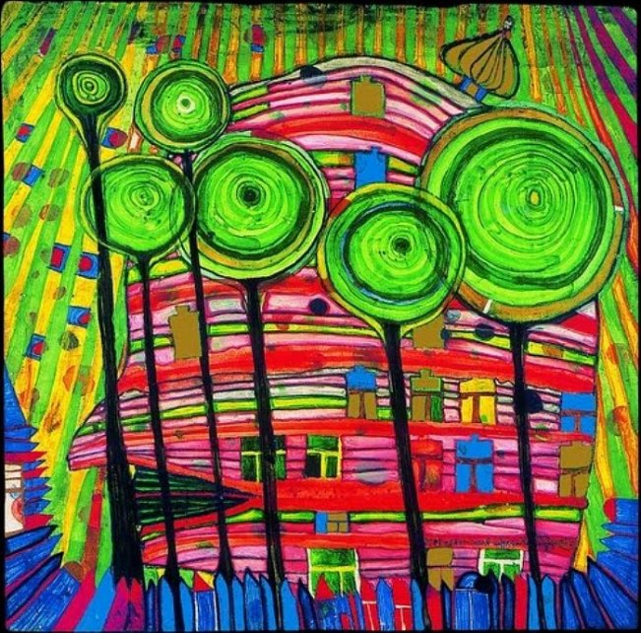
Friedensreich Hundertwasser
Born Vienna 1928
Died on board The QE2 travelling from New Zealand to Europe 2000

Slide 2
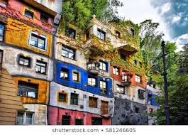
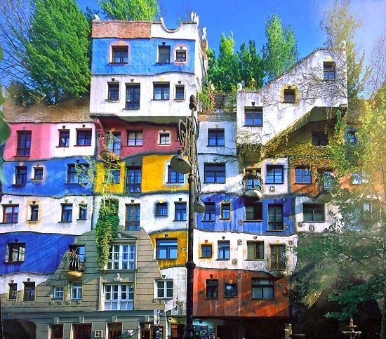
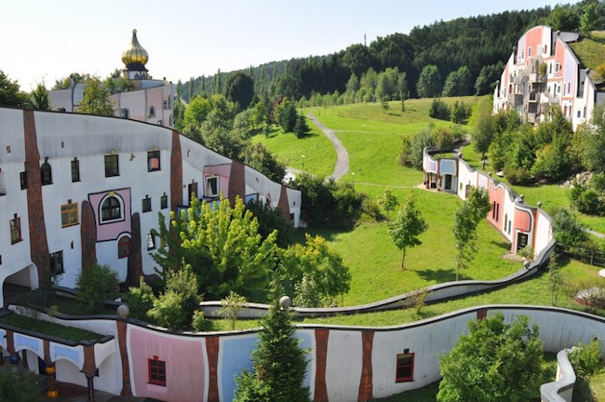
These are some of the buildings Hundertwasser decorated and designed. He believed that people had the right to create the outside of their homes how they wanted.
What do you think about this idea?

Slide 3
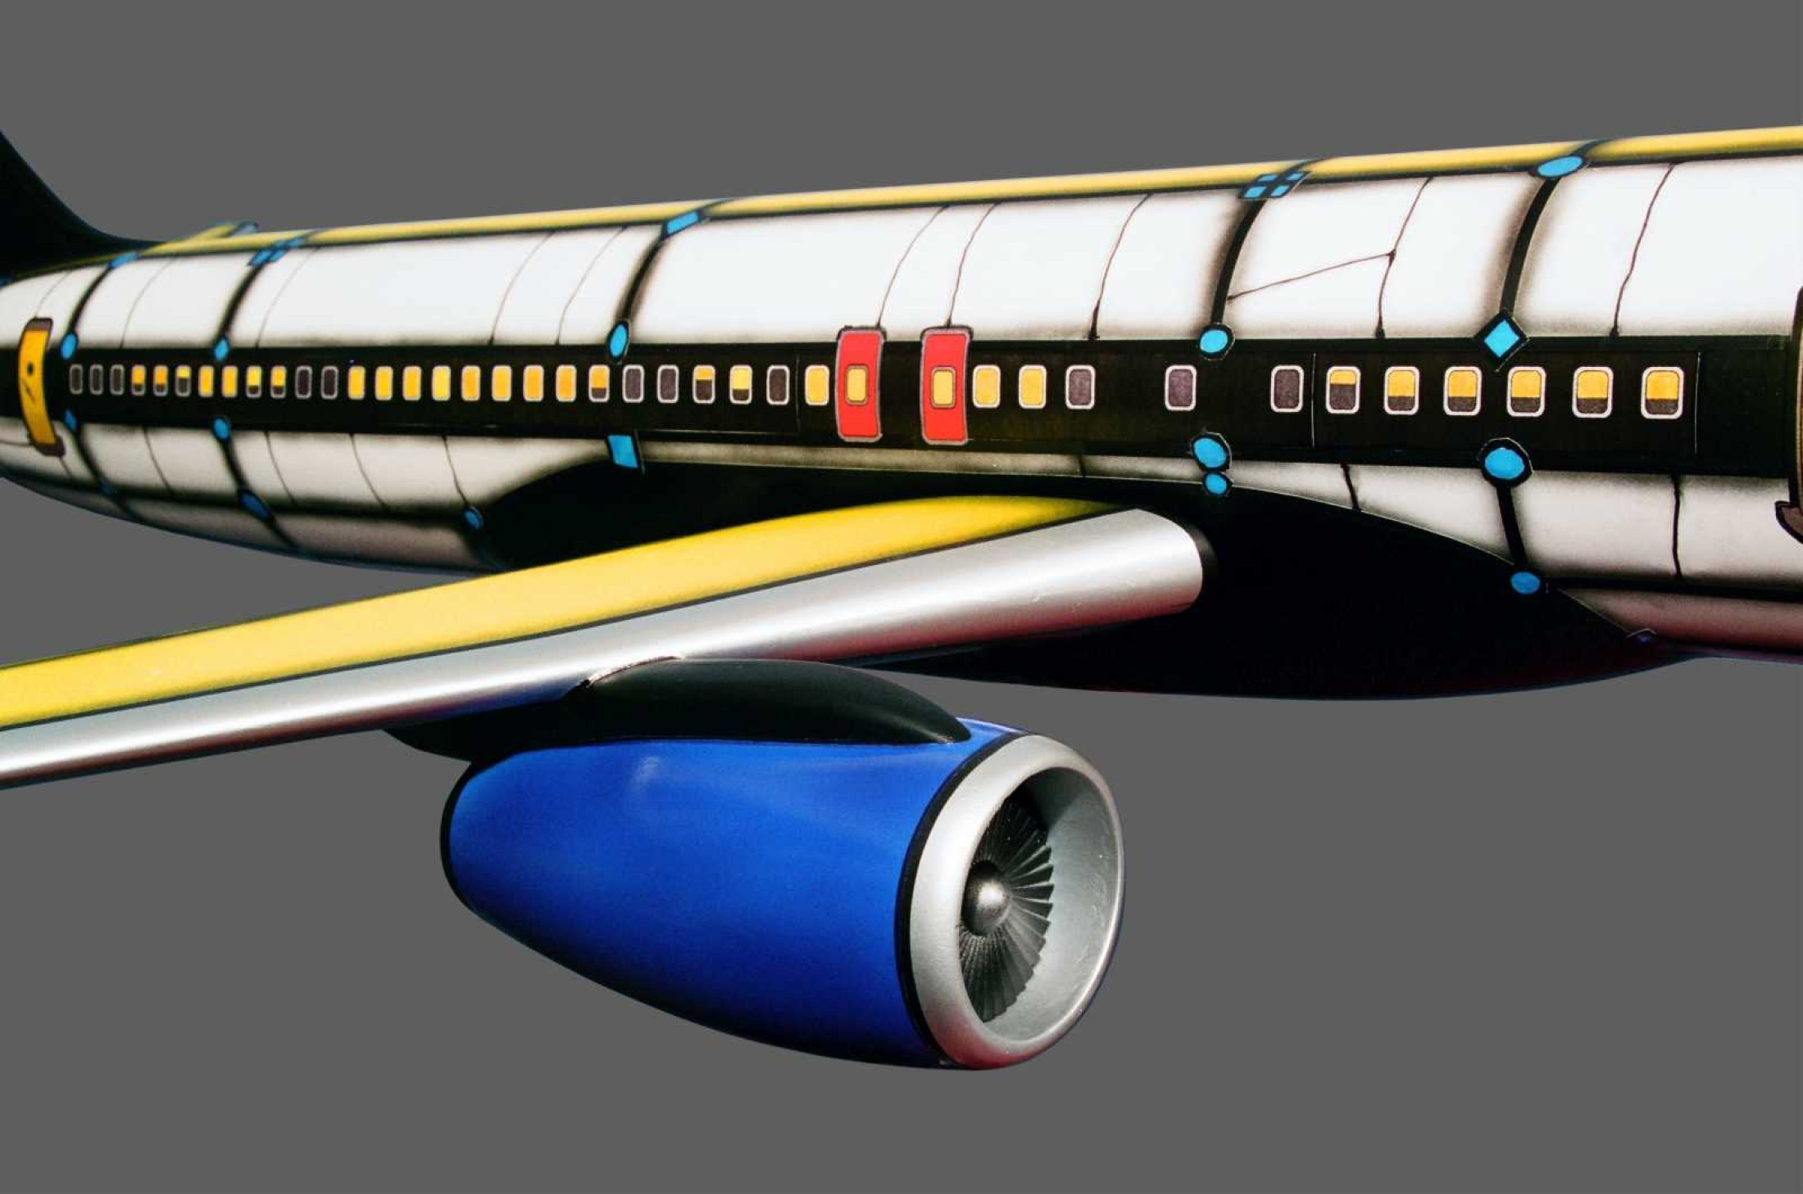
He was asked by Boeing to decorate an aeroplane. Here is what he did.
How might you decorate a vehicle you were going to travel in to make it look more interesting?

Slide 4
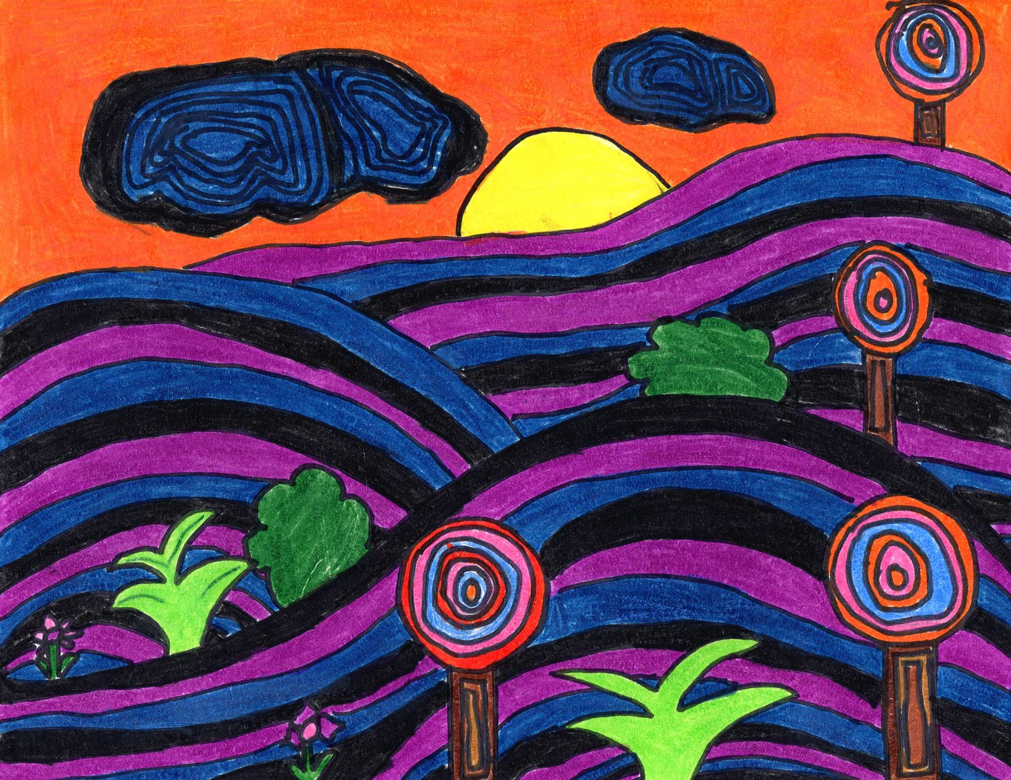
This is a landscape picture that Hundertwasser painted.
He liked to use a lot of spirals in his artwork.
Spirals appear in lots of places in nature – snail shells, sunflower heads, fingerprints and even outer space. You can also link this with maths and the Fibonacci sequence.
To work out this sequence you add the two previous numbers:
1, 1, 2, 3, 5, 8, 13, ……….
1+1 = 2
1+2 = 3
2+3 = 5
3+5= 8
Can you see the pattern?
Maybe you could continue it.

Slide 5
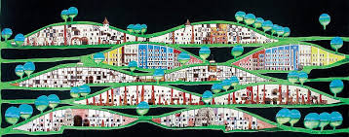
https://kids.kiddle.co/Friedensreich_Hundertwasserhttps://kids.kiddle.co/Friedensreich_Hundertwasser
Use this link to find out more about him.
Enjoy being creative with your Hundertwasser style art or architecture – what can you create using his style?

