Slide 1
Science - Year 4
Living Things & their Habitats – Block 4LvH
Name That Living Thing!
Session 3
Classification PowerPoint
© Original resource copyright Hamilton Trust, who give permission for it to be adapted as wished by individual users.
We refer you to our warning, at the foot of the block overview, about links to other websites.

Slide 2
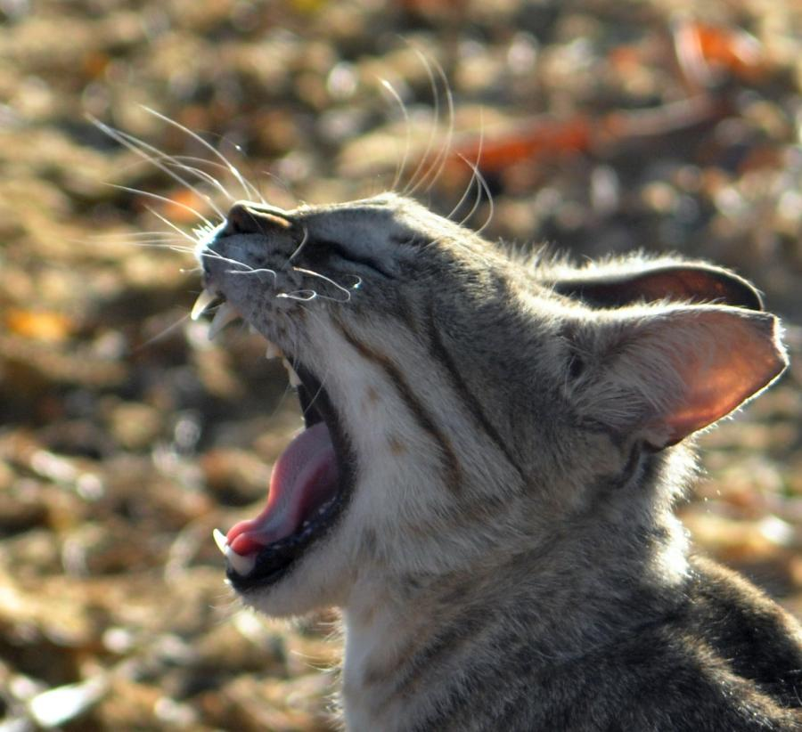
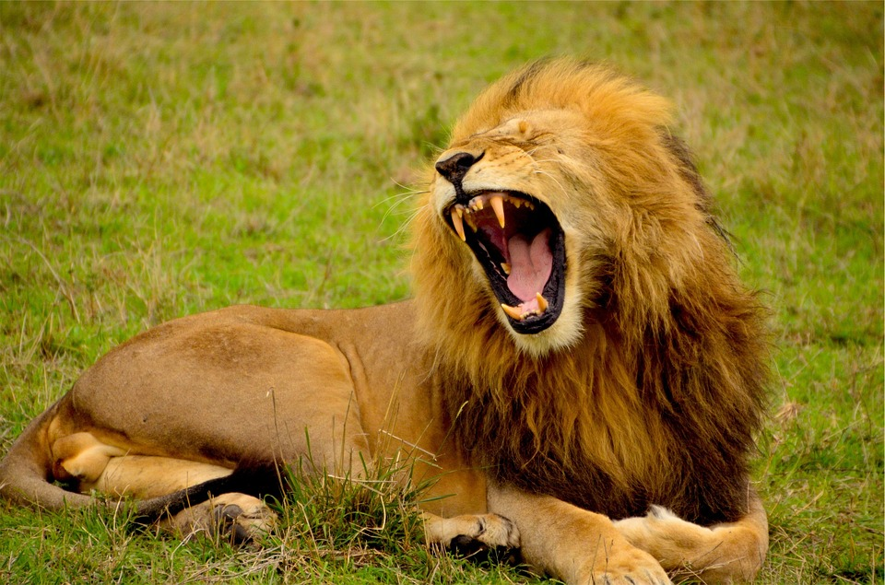
Let’s get sorting!

Slide 3
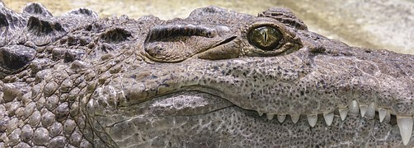
There are about nine million different types of living thing on Earth – and they are all named!
Can you write that number in figures?

Slide 4
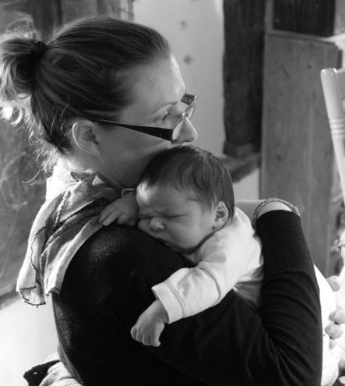
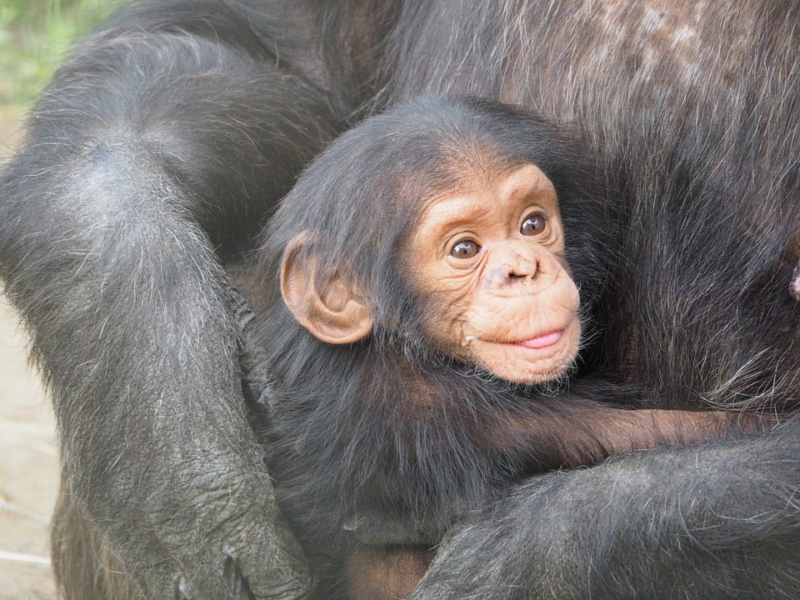
Which species do you think humans are the most similar to?

Slide 5
In fact around 98% of chimp genes (tiny parts in all your cells which give you certain characteristics, e.g. colour of eyes, and which can be passed on to the next generation) are the same as human genes, but there are obvious differences in appearance and behaviour. Can you think of some differences?
chimps: more hairy, different shaped jaw & nose, move around on all 4 limbs, have longer arms & shorter legs

Slide 6
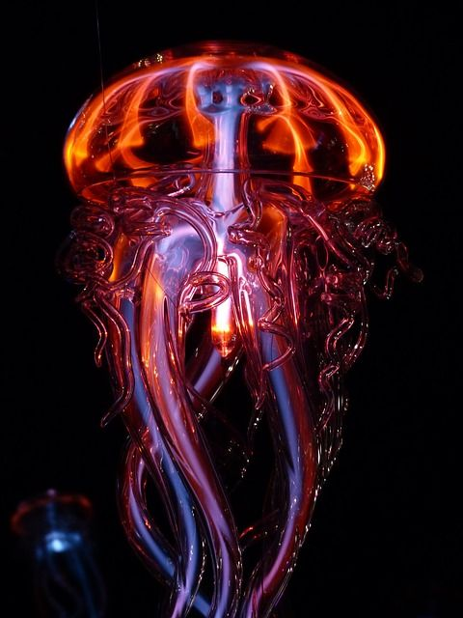
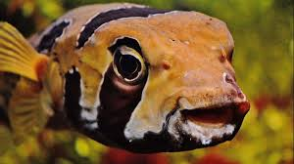
Sorting this large number of species into groups based on similarities helps people to know which living thing is being talked about. Scientists can be sure they are investigating the same species. Two, very large, groups of living things are animals and plants. We are part of the animal kingdom. These groups are however still too big (about 7.8 million animal species) so they have to be sub-divided. Animals are split into vertebrates and invertebrates. Can anyone explain what those words mean?
Invertebrates have no backbone (spine) and vertebrates do.

Slide 7
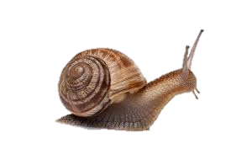
There are far more invertebrates than vertebrates – some are very simple like sponges, others are more complex like insects, spiders (arachnids) and molluscs.

Slide 8
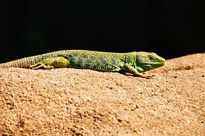
Vertebrates are split again into fish, amphibians, reptiles, birds and mammals.
Am I a reptile or an amphibian?
Click here to watch a clip about animal classification: http://www.bbc.co.uk/education/clips/zpqcfrd

Slide 9
Plants can be grouped into flowering and non-flowering (e.g. ferns & mosses) plants.

Slide 10
Branching databases

Slide 11
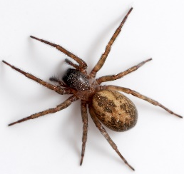
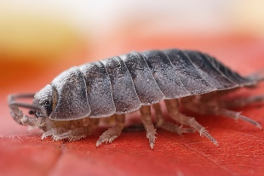
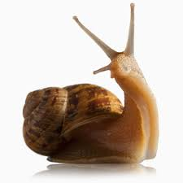
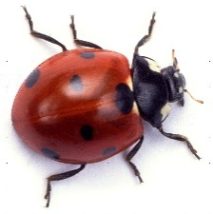
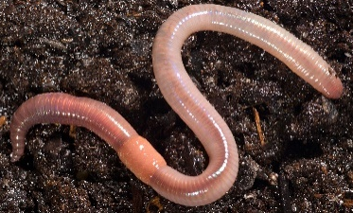
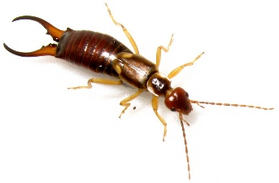
Branching database – dichotomous key
Minibeasts
spider
woodlouse
snail
ladybird
earthworm
earwig
yes
Does it have legs?
no
Does it have 6 legs?
Does it have antennae?
no
yes
Is its body in two main parts?
no
yes
Does it have pinchers?
no
yes
earthworm
snail
no
yes
woodlouse
spider
ladybird
earwig

Slide 12
Sorting Minibeasts – as questions and answers
spider
woodlouse
snail
ladybird
earthworm
earwig
Does it have legs? Yes – go to 2
No – go to 3
2. Does it have 6 legs? Yes – go to 4
No – go to 5
3. Does it have antennae? Yes – It is a snail
No – It is an earthworm
4. Does it have pinchers? Yes – It is an earwig
No – It is a ladybird
5. Is its body in two main parts? Yes – It is a spider
No – It is a woodlouse

