Slide 1
Science - Year 4
Living Things & their Habitats – Block 4LvH
Name That Living Thing!
Session 4
Drawing PowerPoint
© Original resource copyright Hamilton Trust, who give permission for it to be adapted as wished by individual users.
We refer you to our warning, at the foot of the block overview, about links to other websites.

Slide 2
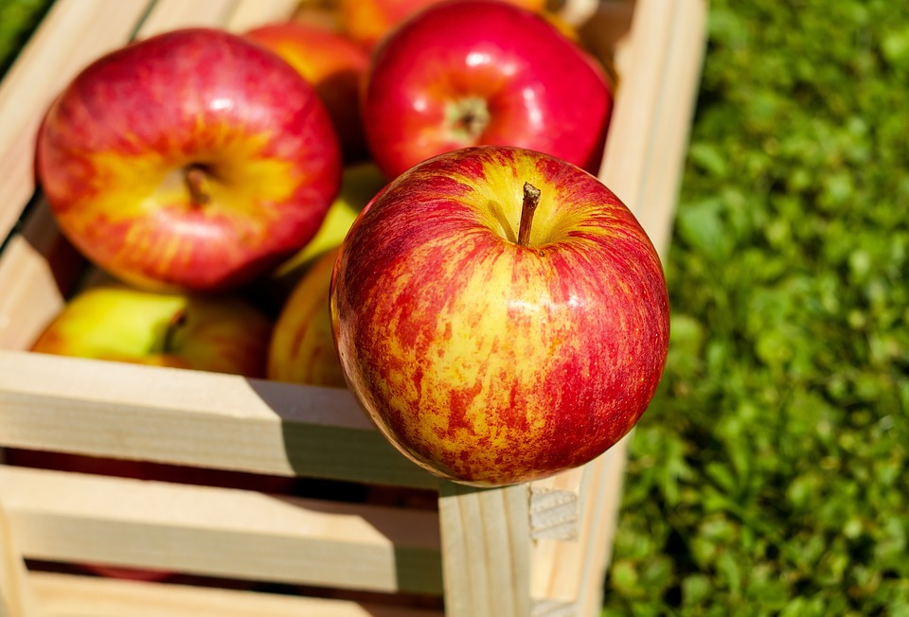
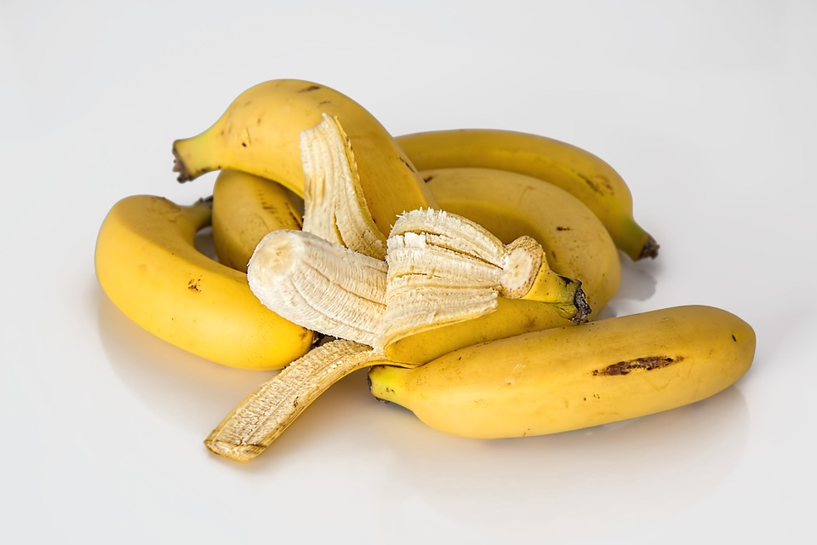
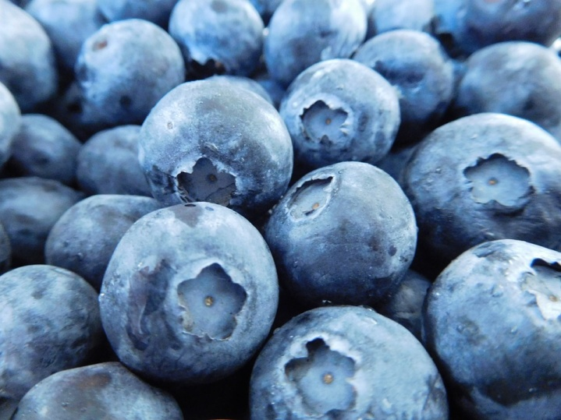
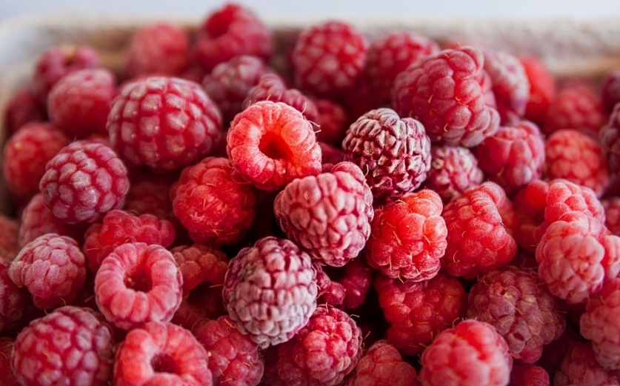
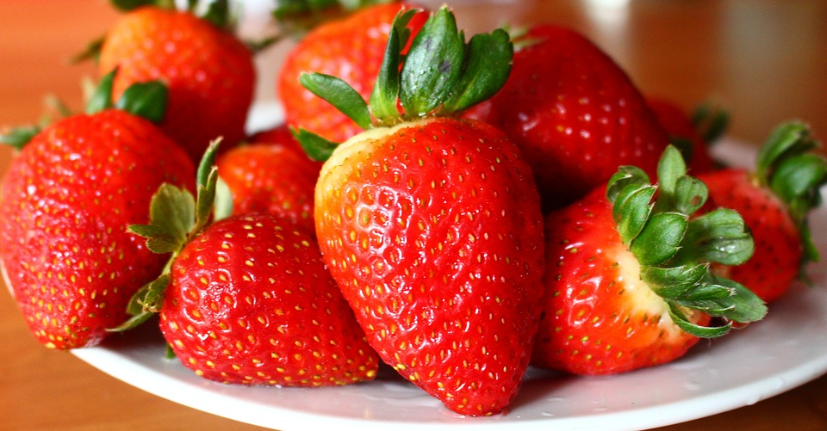
Find a partner. Choose your favourite of these fruits, but don’t tell them which one it is.
Create a branching database to decide which fruit your partner has chosen.

Slide 3
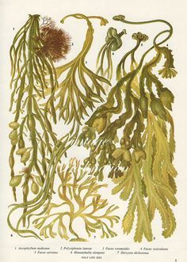
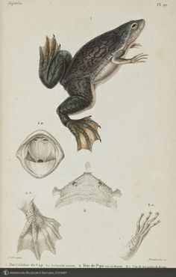
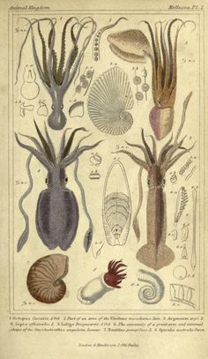
For centuries, scientists have used careful and detailed drawings to better understand living things.

Slide 4
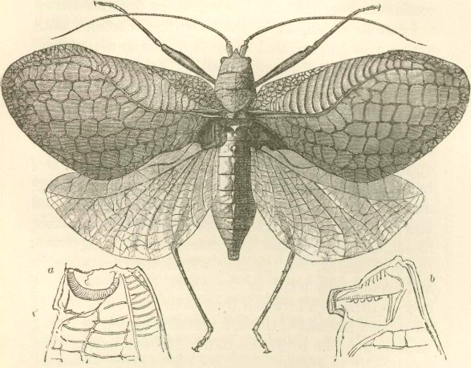
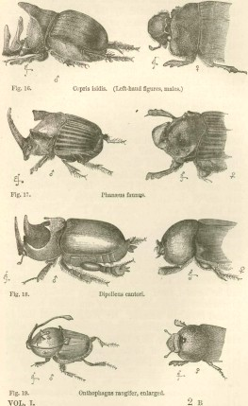
The detailed drawings by naturalist Charles Darwin helped us to better understand living things from around the world.

Slide 5
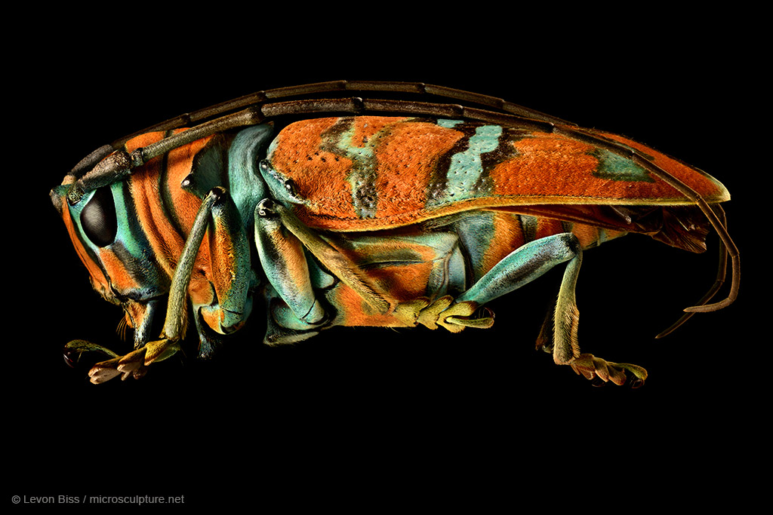
Although sketches and notes are still made by scientists, the artist Levon Biss is using a more modern approach to capturing the detail of some beautiful invertebrates.
http://microsculpture.net/

