Slide 1
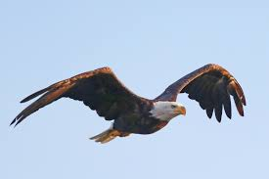
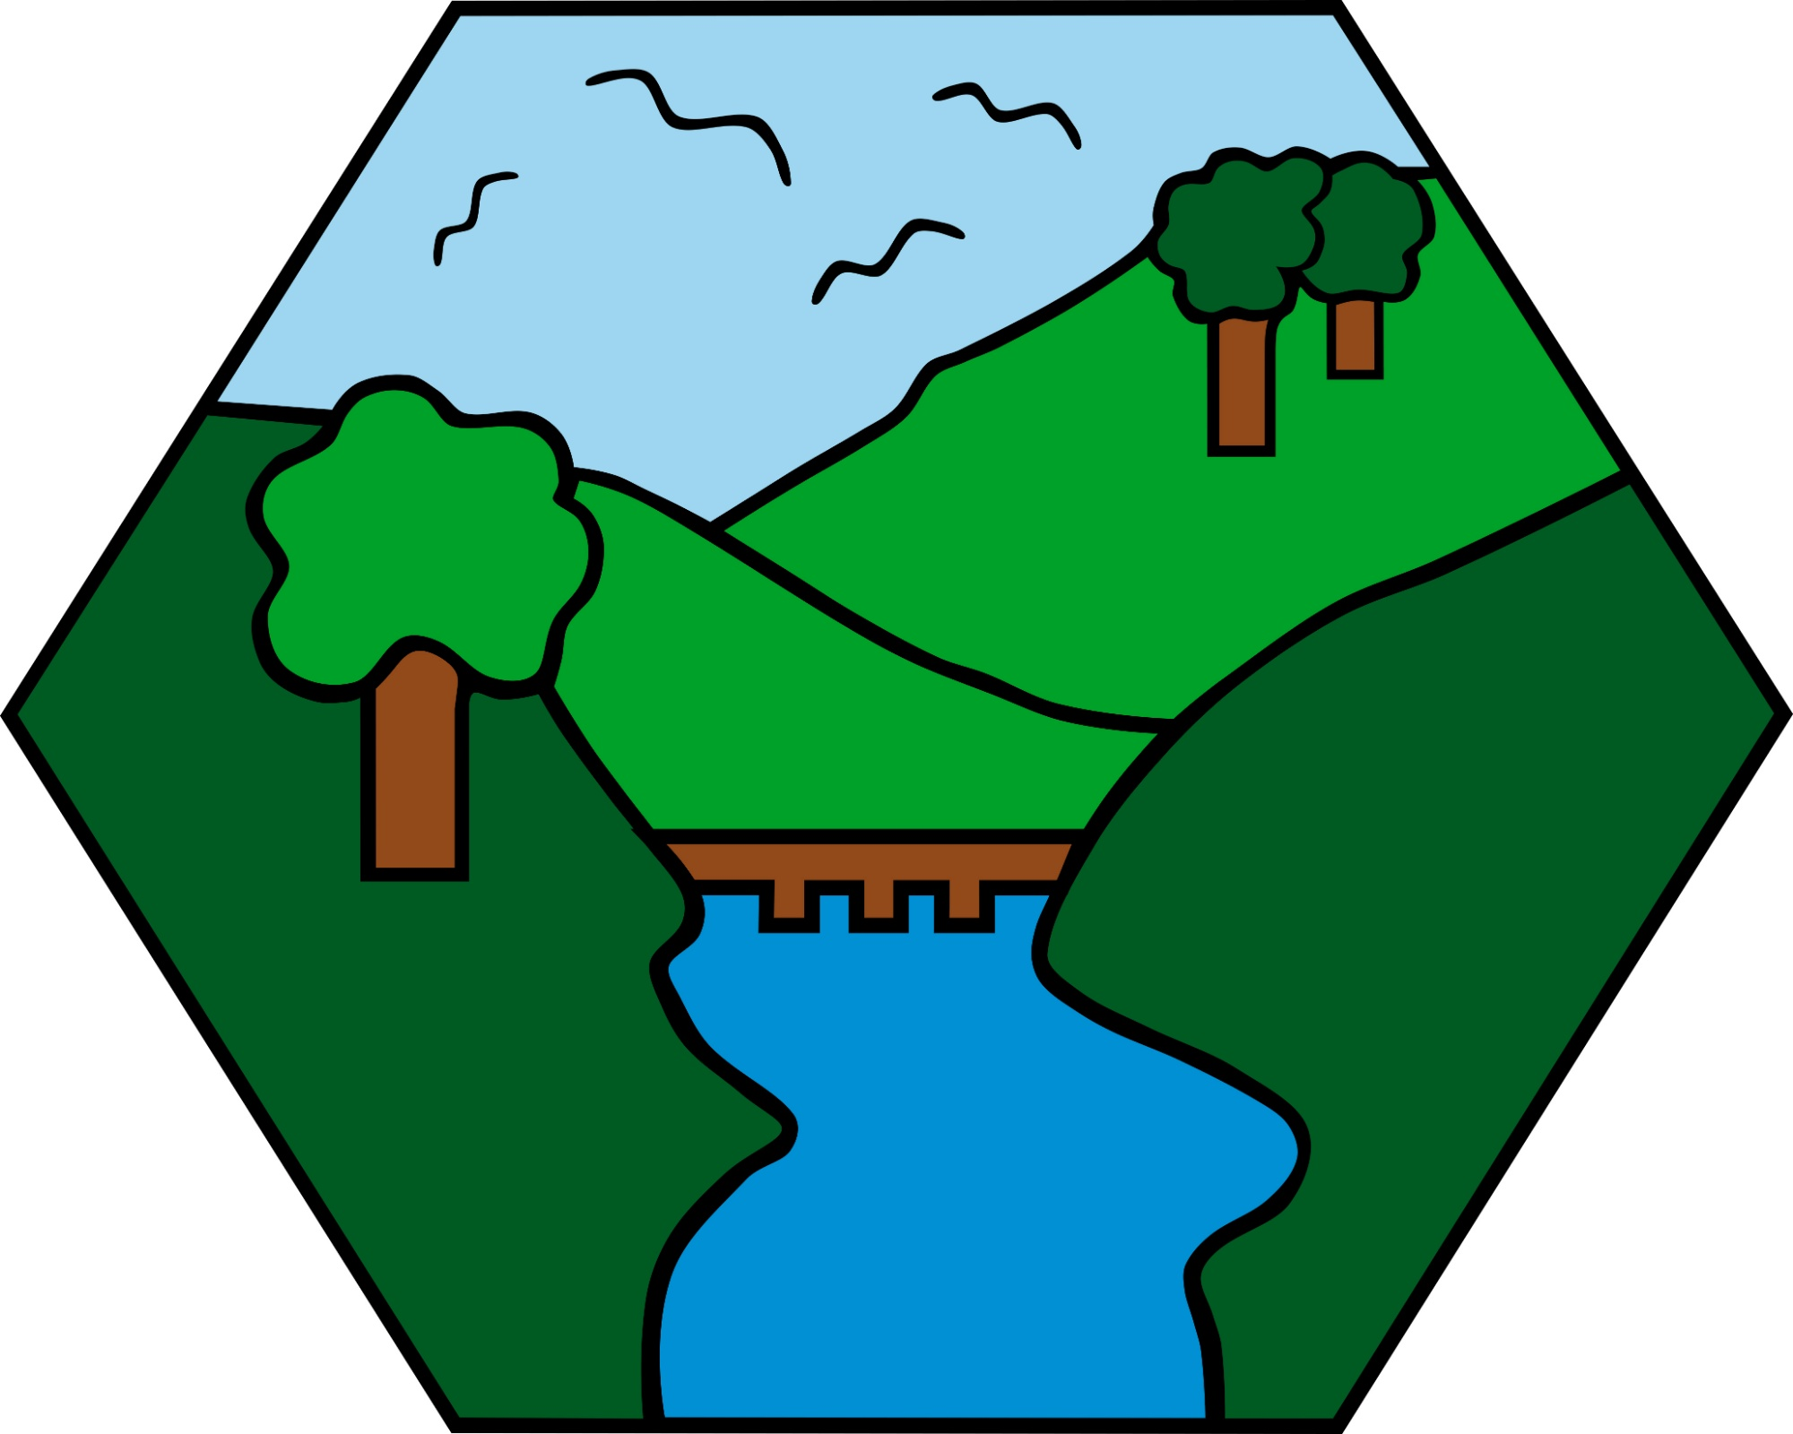
Year 6 Careers Week
The Future of Eagles
Part 1
Credit @primaryteachew

Slide 2
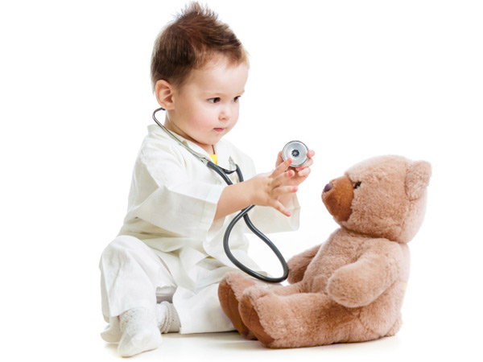
Doctor
I’m a paediatrician which is a Doctor specialising in Children’s health. I care for children from birth until their 18th birthday with a variety of medical problems.
How did I get here?
  GCSEs and Alevels: Need good grades in Sciences but can also do non-science subjects. I took Geography A-level.
  Studied Medicine at University: 5 or 6 year course with the chance to go abroad. I went to Australia for 3 months.
  Foundation Dr: 2 years of trying different medical specialties
  Paediatric training: 8 year programme to become a consultant paediatrician
What’s good about the job?
  Different every day
  Get to work with a team and meet lots of different people
  Working with children is fun- they always make you smile
  Flexible career- can take time out to travel, do research or teach.
  Well respected
  Good pay
What’s not so good?
  Work shifts including nights and weekends
  Can be quite sad when things don’t go well
Tasks:
1: Doctors need to be good at handwashing: put on a pair of rubber gloves and use paint as handwash- can you cover the gloves in 20 seconds? Which bits did you miss?
2: Doctors need to be good at communicating. Imagine you have found someone unwell in the street and practice having to “call an ambulance” with a friend or parent. You need to be able to tell the operator you want an ambulance, where you are (as clearly as possible- look for landmarks or street signs) and what has happened to the person.
See https://www.youtube.com/user/stjohnambulance to learn more about first aid

Slide 3
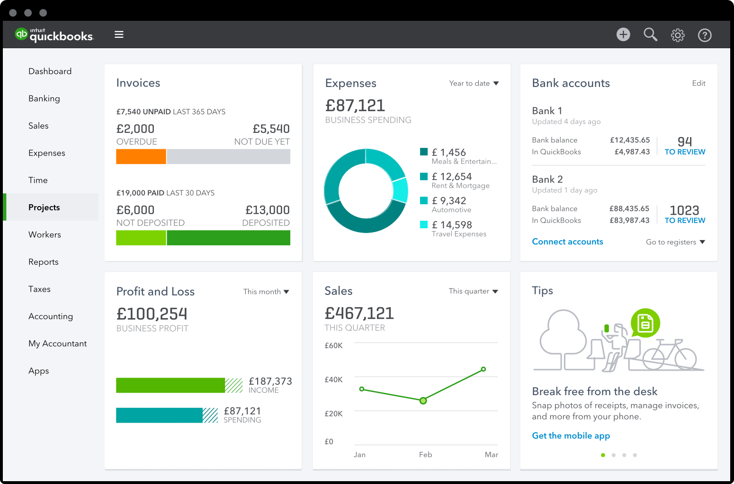


Trainee Accountant
What is an Accountant and what do duties include?
Accountant job duties include providing tax advice, helping companies report their financial situation, bookkeeping and data analysis. In an accountancy firm (or ‘a practice’), you will work with other companies and individuals to help them pay the right tax, compile their accounts, and then use that information to help them grow and make more money.
What do I do in my role as a Trainee Accountant?
The jobs I do in my role are similar to the description above but on a more basic level as I am training & still learning. I process Payroll (People’s wages), VAT Returns (Companies & Non companies Value Added Tax returns) to advise them of how much VAT they owe to the Government (HMRC), I also process accounts for self employed (sole traders & partnerships).
What do I most enjoy about my job?
I enjoy problem solving and constantly working out calculations which keeps my brain active allowing days to go quickly. I also enjoy that no day is the same and I get to meet clients/ business owners on a regular basis
Activity- Due to accounting being like Maths. Give this a try.
You have been given a bank account. Can you work out, after the incoming and outgoings, how much money is left?
How did I get to where I am? How do I get to where I want to be? Are there other routes to the same result? Lastly what made me want to be an accountant?
I got to where I am now by working hard at school, especially in maths by practicing all the time and challenging myself to learn. After school I decided to carry on my studies by continuing to learn as I studied Accounting levels 2&3 with AAT which is an accounting exam body. I am currently studying AAT level 4 and all being well I shall go on studying to qualify as a Chartered Accountant. Alternative routes in the accounting industry include going to University then on to Chartered Accounting.
I decided I want to be an accountant because I have always enjoyed maths, finance & business. If you like: Maths, problem solving and have an analytical brain then accounting could be for you.

Slide 4
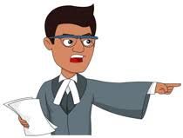

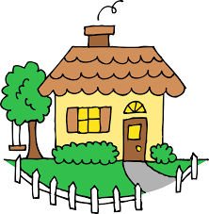
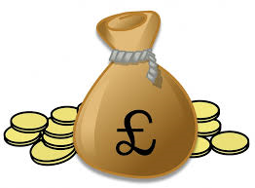
Lawyer
A lawyer is a professional who is qualified to offer advice about the law. Lawyers help people in everyday life across many different areas.
Types of law
The most recognised is a criminal
lawyer which is often seen on tv.
This lawyer defends people accused
of crimes.
Family lawyers help people who are getting divorced, or sometimes they help children who are mistreated to find better homes
Real estate lawyers help people
buy and sell houses.
Corporate lawyers help inventors protect their inventions from other people stealing their ideas as well as buying and selling businesses.
This is only a small sampling of the types of jobs lawyers do.
Becoming a lawyer
Good GCSEs and A levels are needed as well as a university degree and you need to pass law school. Once you have done your GCSEs, it takes a minimum of 8 years to become a qualified lawyer. Being a lawyer takes hard work, dedication and many years in education.
Why become a lawyer?
Lawyers spend a lot of their day in meetings or on the phone, therefore it is very sociable.
The law changes yearly so lawyers are always learning!
Lawyers do a lot of good in the world. Sometimes lawyers help parents adopt children from other countries so they can have loving homes or a lawyer might help bring someone to justice who has harmed an animal.
And the best bit - lawyers often get paid well too!

Slide 5
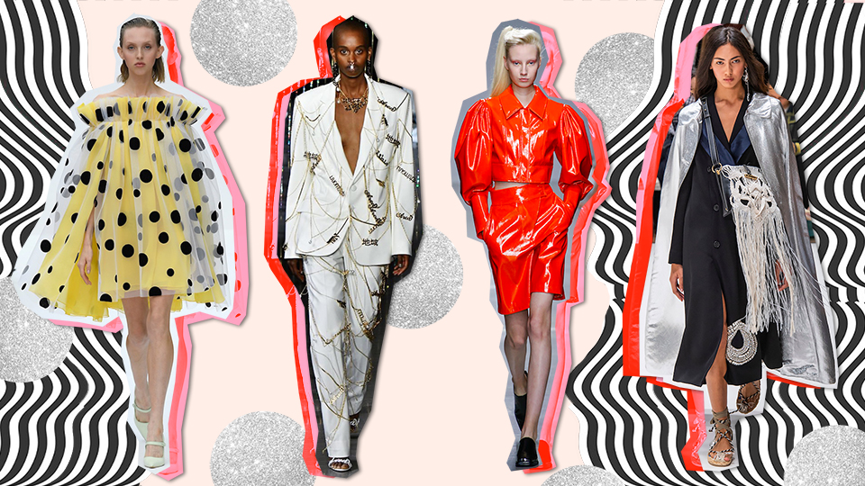
Garment Technologist
I have a very exciting job working in fashion for a company that makes clothes for New Look, so you might have some of our designs in your wardrobe! I make sure clothes fit properly and check they have been made to a great standard - no one wants a pair of jeans with a hole in!
I’ve had amazing experiences travelling all over the world to visit the garment factories so I’ve seen how clothes are made from start to finish! This includes dyeing fabric, pattern cutting, sewing all the pieces together, pressing the garment so it’s neat and packing the goods so they can be sent to the U.K. to be sold in our shops.
I went to college to study for my A Levels so that I could go university and complete a degree in Fashion Design - you need to try and get as much experience as possible to get a job in fashion as it’s very competitive but a very exciting environment to be part of!
ACTIVITY
From your wardrobe, choose out 5 items of clothing. There should be a white label inside which tells you what the garment is made from. Research where each of these fibres come from e.g.a jumper might be 100% wool, wool comes from sheep!

Slide 6
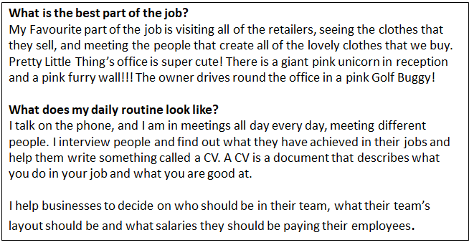
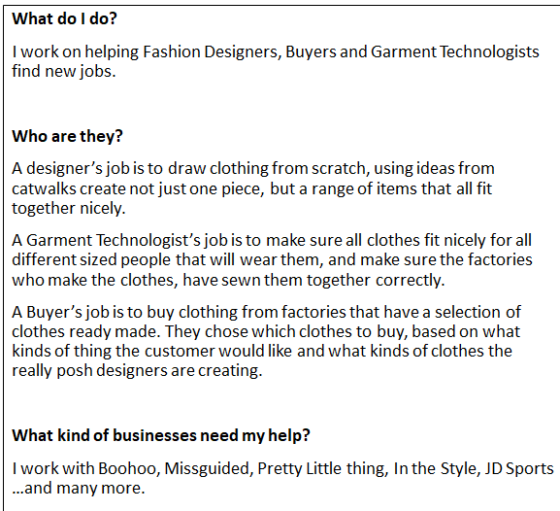
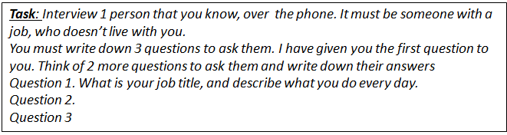
Recruitment Consultant

Slide 7
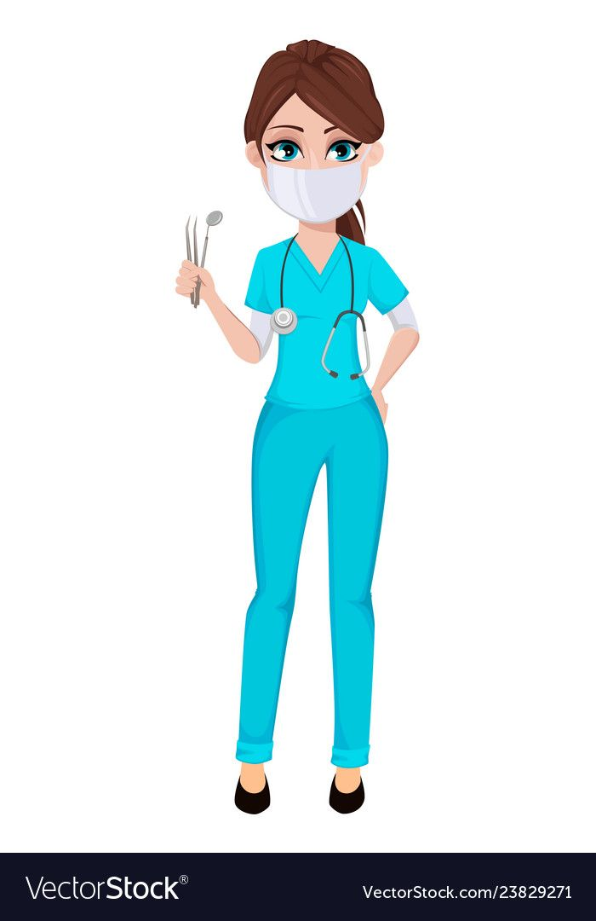
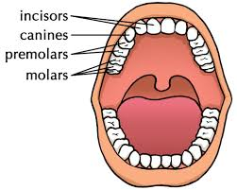
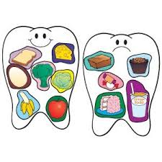
Do you want to be a dentist?
What do we do?
Improve the health of teeth and gums.
Fillings, removal of teeth, cleaning teeth.
Give advice on healthy foods and drinks.
Take X-rays.
Straighten teeth with braces.
I would suit this job if I…
Enjoy working with people.
Am a caring person who likes to help others.
Am good at working as part of a team which includes dental nurses, receptionists, hygienists.
Enjoy ‘hands on’ practical activities.
Enjoy science subjects at school.
Am not too squeamish!!!
Good foods/Bad foods
How do I become a dentist?
*GCSE’s
*Work experience at a dental
practice during school holidays.
*A Levels in Chemistry and Biology/Physics
*Dental Degree (5 years)

Slide 8
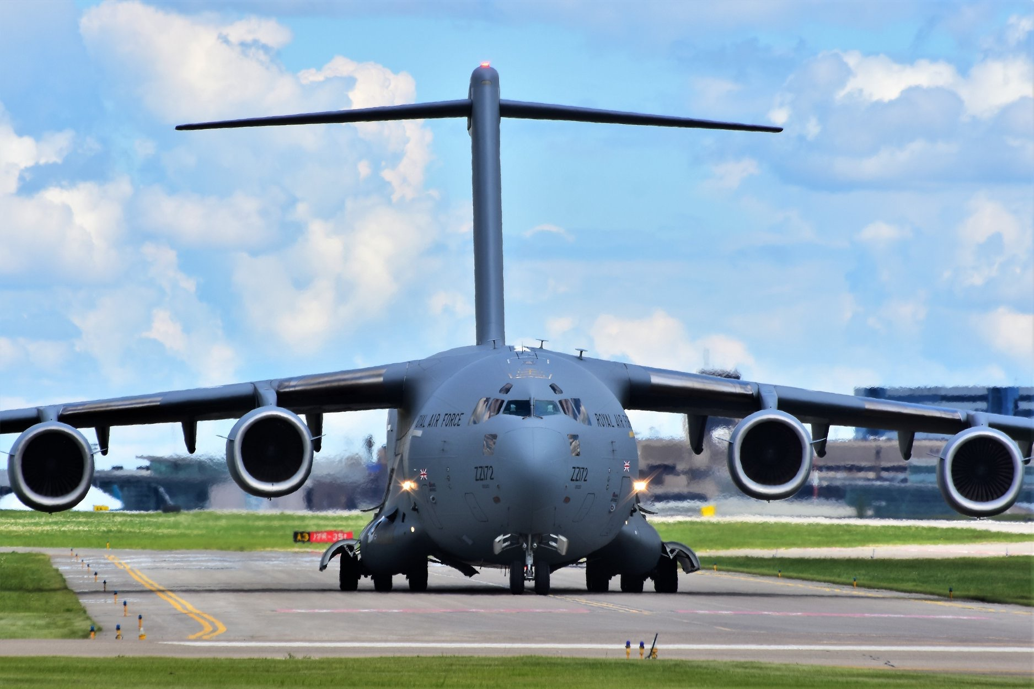
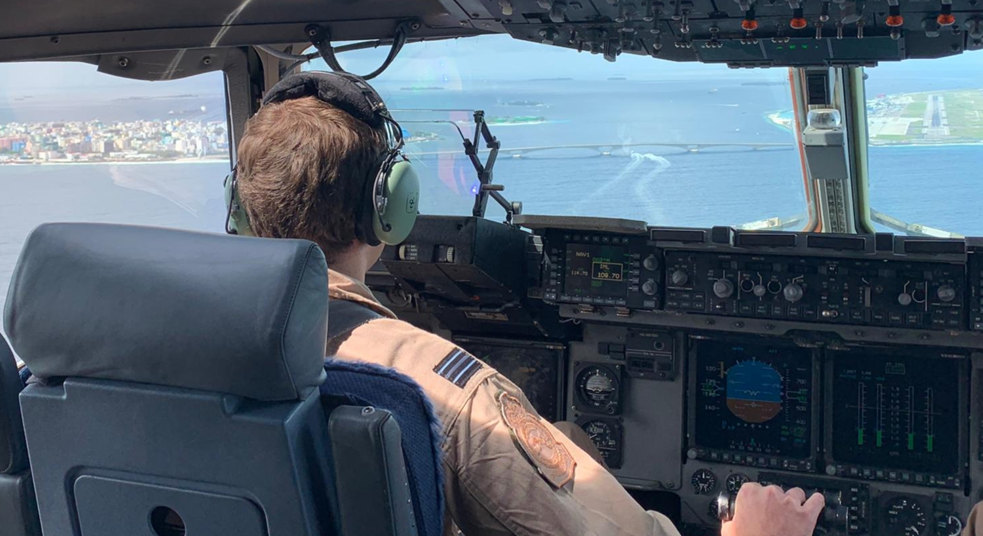
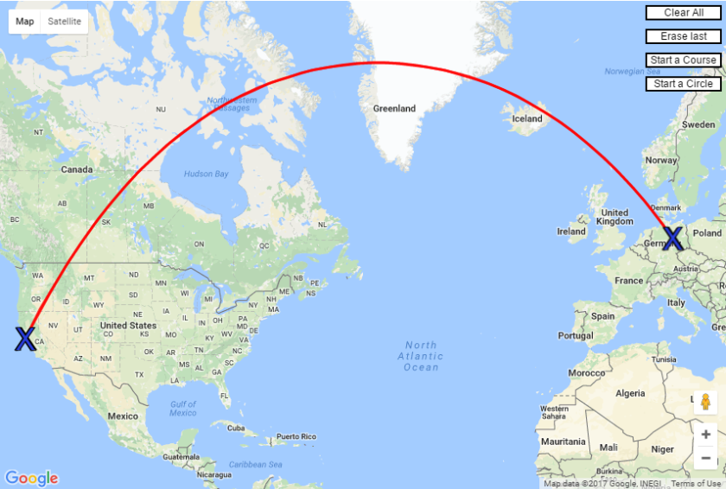
Pilot
I’m a C-17 Pilot in the RAF. The C-17 is the largest cargo aircraft in the RAF. When fully loaded, it weighs more than 265 tonnes. The C-17 can carry cargo, passengers, helicopters and even tanks!
After my A-levels, I studied Maths at University before starting Pilot training that takes 5 years.
What’s the best part of my job?
Every day is different and brings a new challenge! The job takes me all over the world, from Afghanistan to Las Vegas! The most rewarding part of the job for me is flying medical supplies into places where they have no other way of getting them.
Task
If you want to save time and fuel, which route would you fly? Red or black, and why?

Slide 9
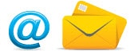

Vicky - Direct Marketing Manager
What is Direct Marketing?
This is a method of advertising where we pre-select our ‘target group’ (chosen customers) to talk to them about a product or service that is relevant for them - this is otherwise known as a Direct Marketing Campaign, and usually we are trying to persuade customers to do something by incentivising them (for example, by giving a discount to buy something or a prize for a customer survey).
We talk to our customers through different channels of communication, such as mail, email, mobile apps and telephone. We would usually pick a channel that is most relevant to our customers, so for example we might use mobile app messaging for young adults, and instead use mail for an older generation that prefer post.
Direct marketing can be used to increase the number of new customers for a business, or it could be used to speak to existing customers which helps to keep a relationship with them (and hopefully encourage existing customers to buy again!)
What are the best bits about my job?
Personally I love bringing every aspect of a campaign together. This includes deciding the ‘target group’, organising our creative (what the campaign will visually look like), project managing the launch of the campaign and finally reviewing performance, so we can always look to improve future communications with our customers.
My journey to becoming a Direct Marketing Manager
I studied Business & Economics at GCSE and A Level, and went on to do a degree in Marketing as my chosen area of Business. This is what interested me the most as I found it quite creative. After completing my degree, I spent time working in Marketing agencies supporting companies with their campaigns which was fun and fast paced. I now work for Nationwide Building Society and I am responsible for getting key messages to customers through their Internet Bank and Mobile Banking app.
Your activity
Please create a direct marketing campaign using a poster - you can choose a product of your choice that you would like to advertise.
For the poster, think about the following:
Tell us about your product
Who do you want to target / speak to, and why?
What channel of communication will you use?
What will be your key message for the campaign and will there be an incentive for the customers you are speaking to?

Slide 10
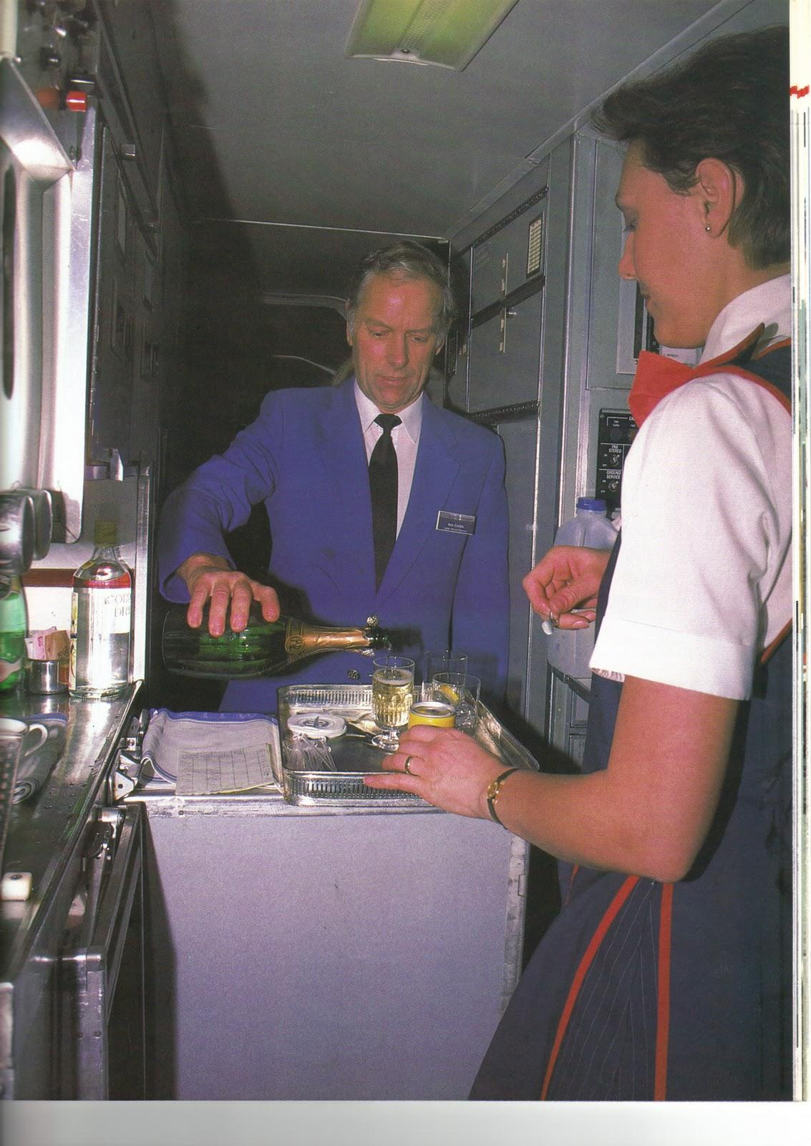
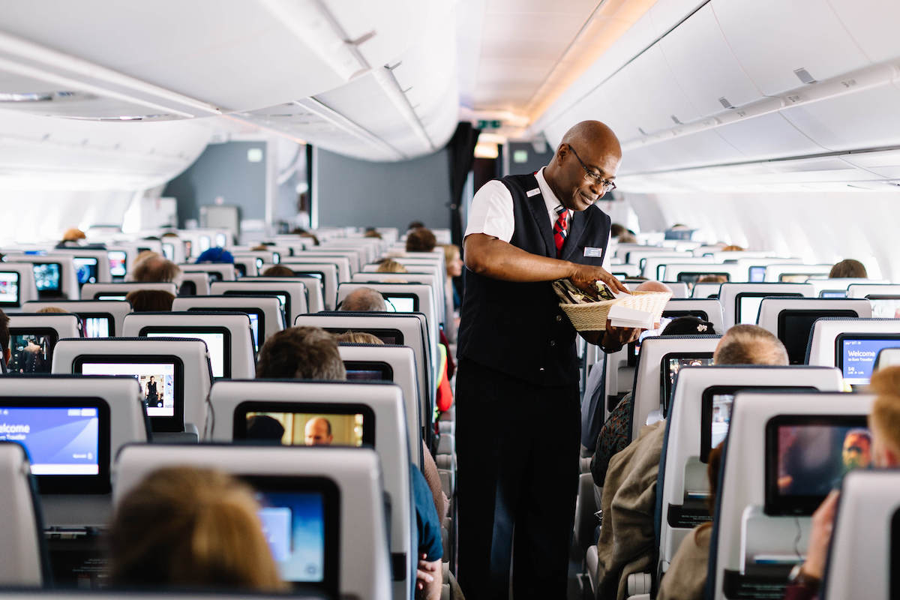
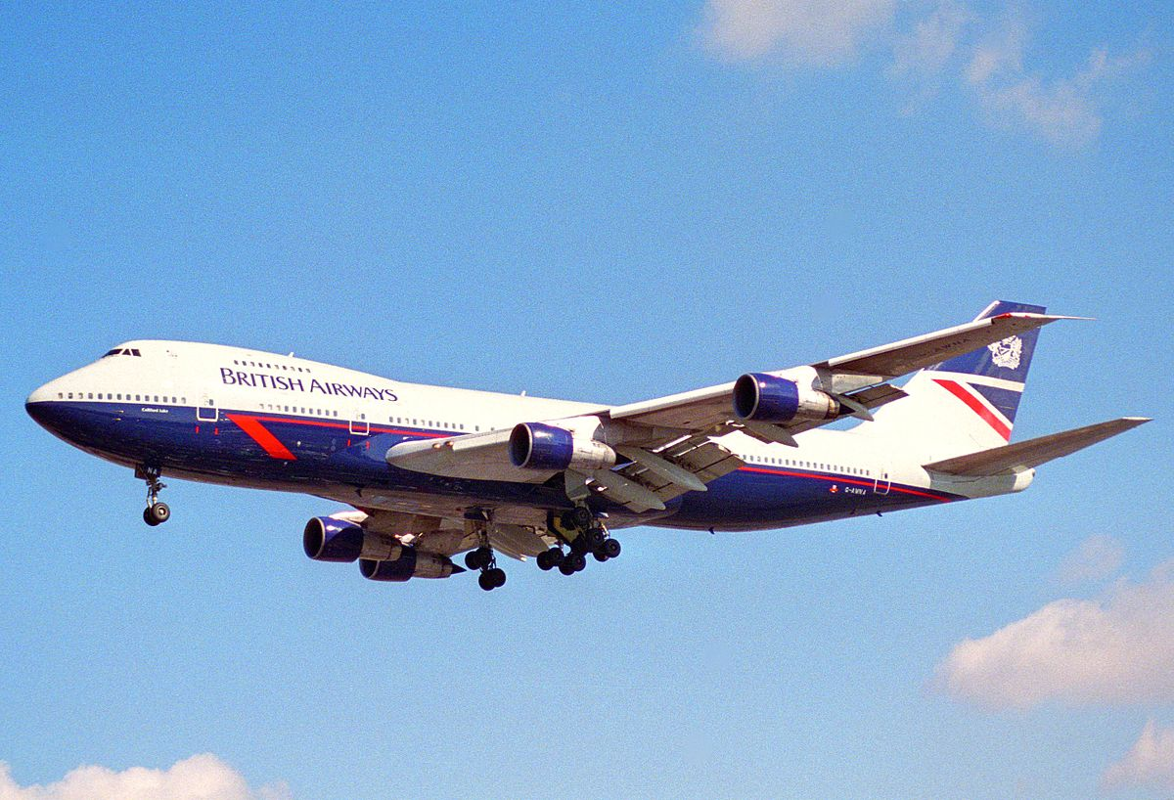
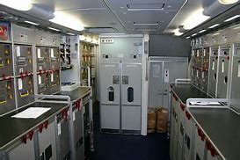
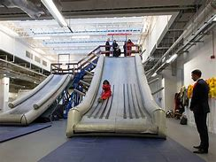
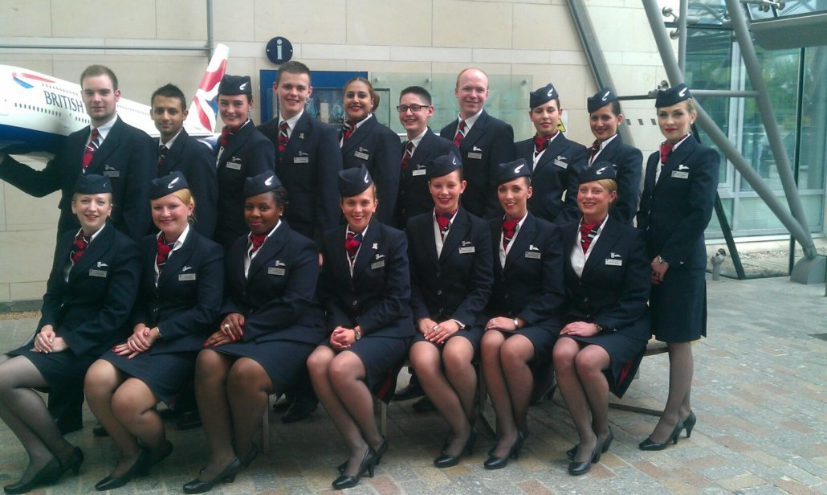
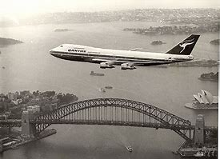
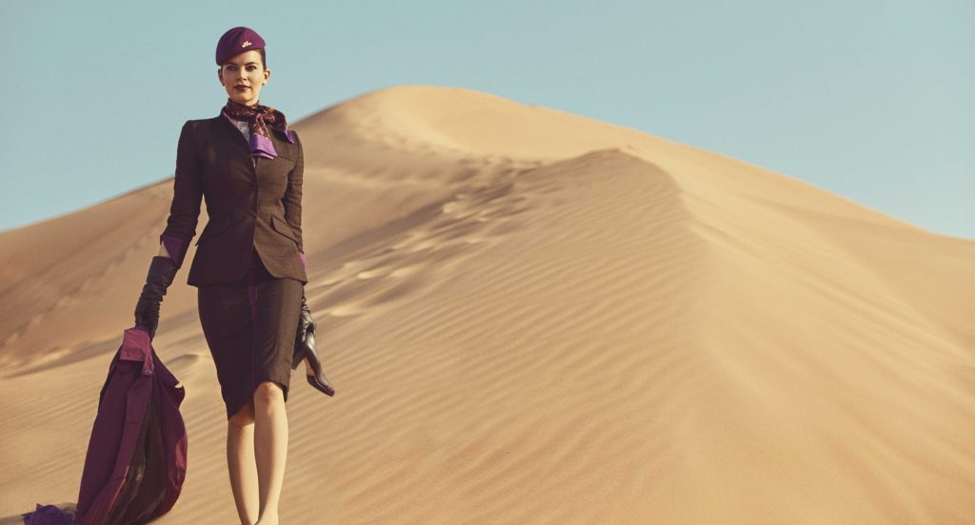
Cabin Crew
I was Cabin Crew for British Airways on 747 Jumbo jets
The best bits were travelling to far off places with a great team, being paid to sit on an exotic beach or visit the sights for a few days then returning home. I mixed with lots of different passengers such as ships crews, Royalty and celebrities. I got to fly with Paul McCartney (The Beatles!) which was a highlight. The major part of the job was safety, followed by keeping passengers happy.
To get there, after passing A levels, I studied Business studies through BA while I worked in their head office. I much prefer being cabin crew rather than an office so asked to transfer...and never looked back!

Slide 11
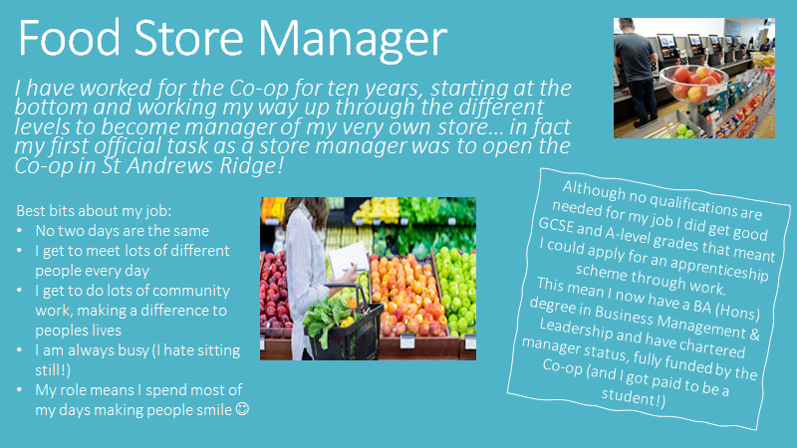

Slide 12
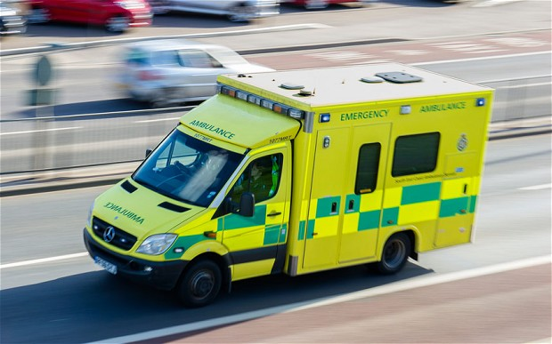
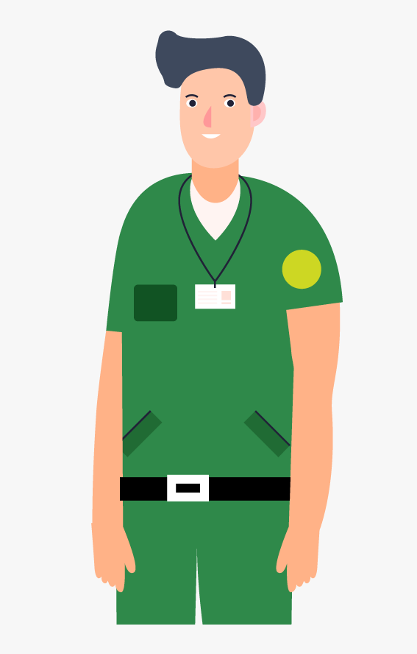
Ambulance Service
Currently I am a software developer and data analyst working with the Ambulance Service helping them forecast their demand which assists with deciding how many ambulances they put out ‘on the road’ every day.
I started out with very few ‘O’ levels (GCSE) and joined the ambulance service many years ago as a Technician. I then qualified as a Paramedic and moved up through the ranks, eventually becoming a Divisional Commander responsible for the operational management of three ambulance stations.
Being a clinician in the ambulance service was a very rewarding role, helping people at times of crisis and treating injuries and illness. It is a job where you can see the best and worst of people in all levels of society. You end up working closely with the police, fire brigade and hospitals. Level-headedness and problem solving are things that help you in the clinical role.
I discovered late in my career that I rather enjoyed dealing with data and statistics and writing computer code which is why I do what I do now. It is never too late to change direction and you will be amazed at the number of opportunities there are out there doing jobs you never dreamt about. Be interested, apply yourself and good things will happen.

Slide 13

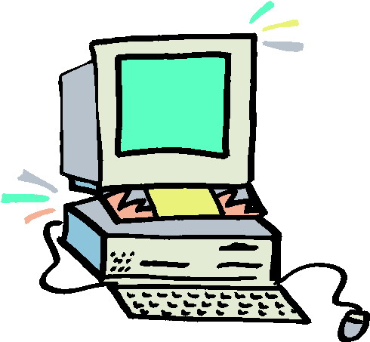
Software Sales
After leaving school with only a few qualifications, I had a sales career selling software to large corporations.
I travelled around the country meeting a large range of people. I helped them make decisions on which software they should purchase.
Some days I was office based while other days I had to drive across the country - I got to see lots of different places! Whilst on visits I would often need to drive 400 miles - listening to music helped the hours pass by!
There were highs and lows, I had a great feeling of success when someone bought (if they did, I earned extra money). I saved the extra money and bought some properties that I now rent out.

Slide 14
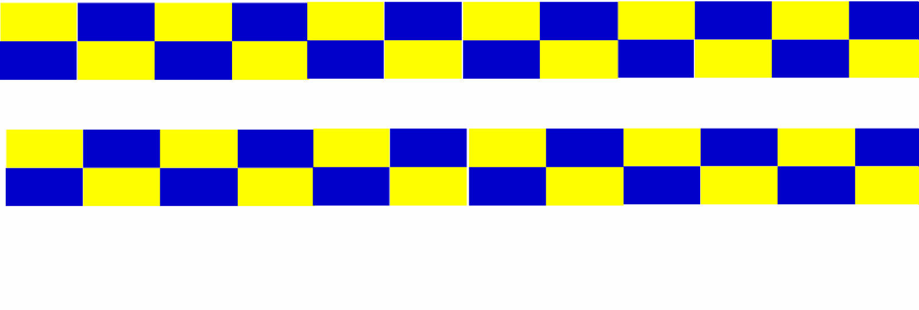

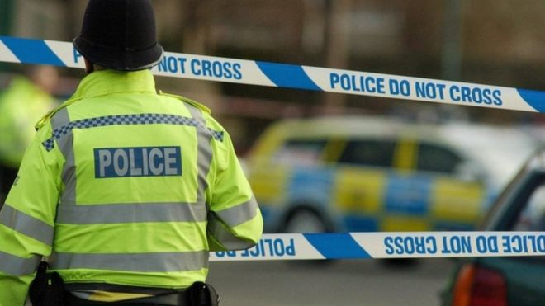
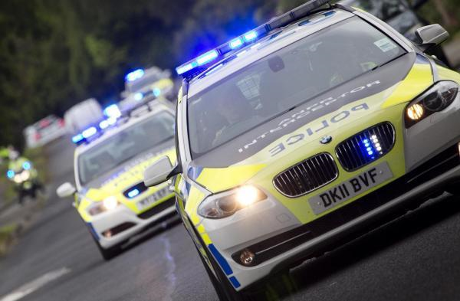
Police Officer
My name is Sam, I am a Police Officer with Wiltshire Police and I patrol the Swindon area. It was always my dream to be a Police Officer, ever since I was 3 yrs old!!
What does a Police Officer do?
Protect the public from violence
Provide a reassuring presence in the community
Support victims of crime and those that have witnessed a crime
Investigate crime
Being a Police Officer is a very interesting and varied job. Every day is different and you never know what you’ll be doing from one day to another. You could be arresting and interviewing a suspect, directing traffic around a crash, or taking a statement from a someone who has had their house broken into. It is very rewarding because you help people and protect them from harm.
My background…I studied Public Services at college and went on to study Police Studies at University too. After University I worked in the Police Control Room answering 999 and 101 telephone calls, and taking crime reports from members of the public.
TASK - make a list of the different types of crimes and incidents that a Police Officer would attend and investigate….

Slide 15
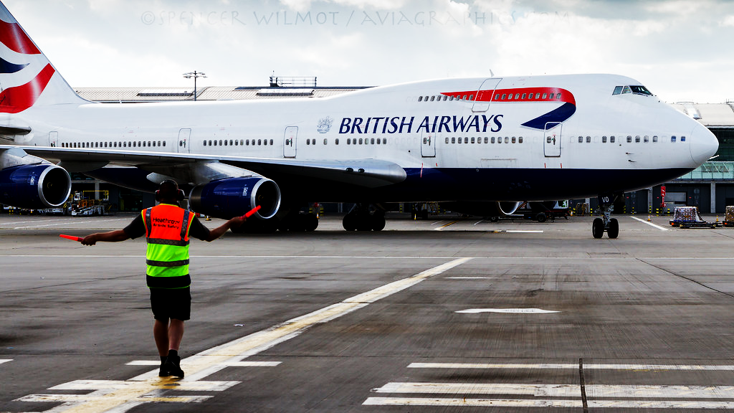
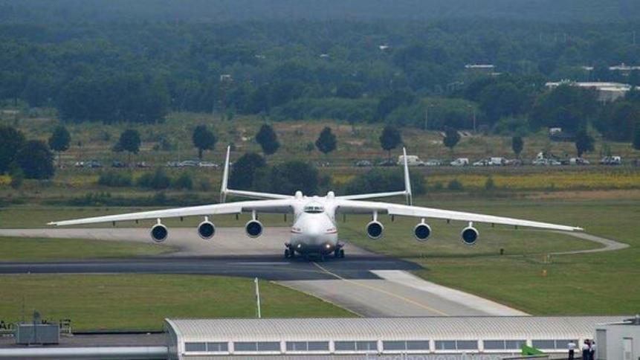
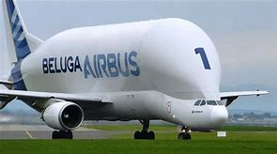
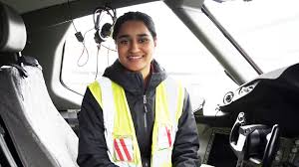
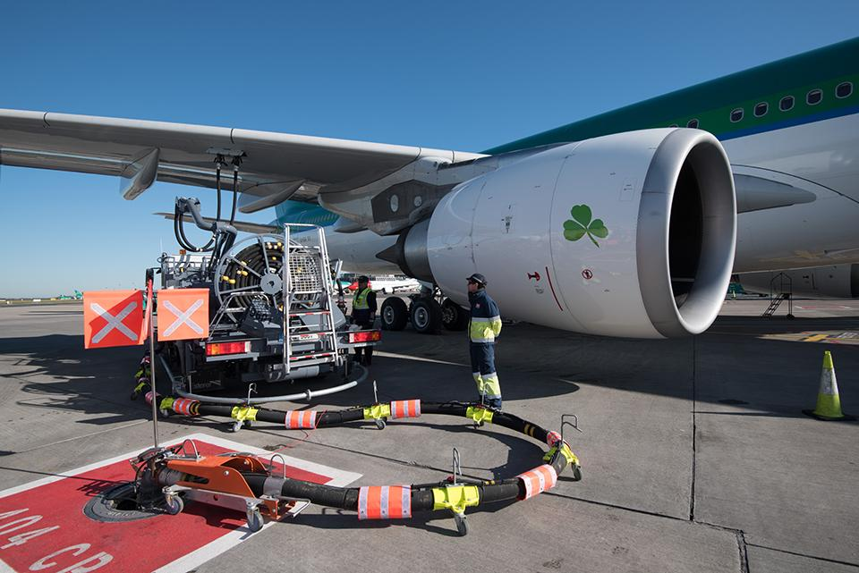
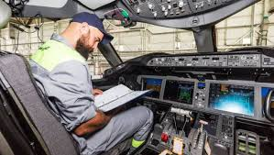
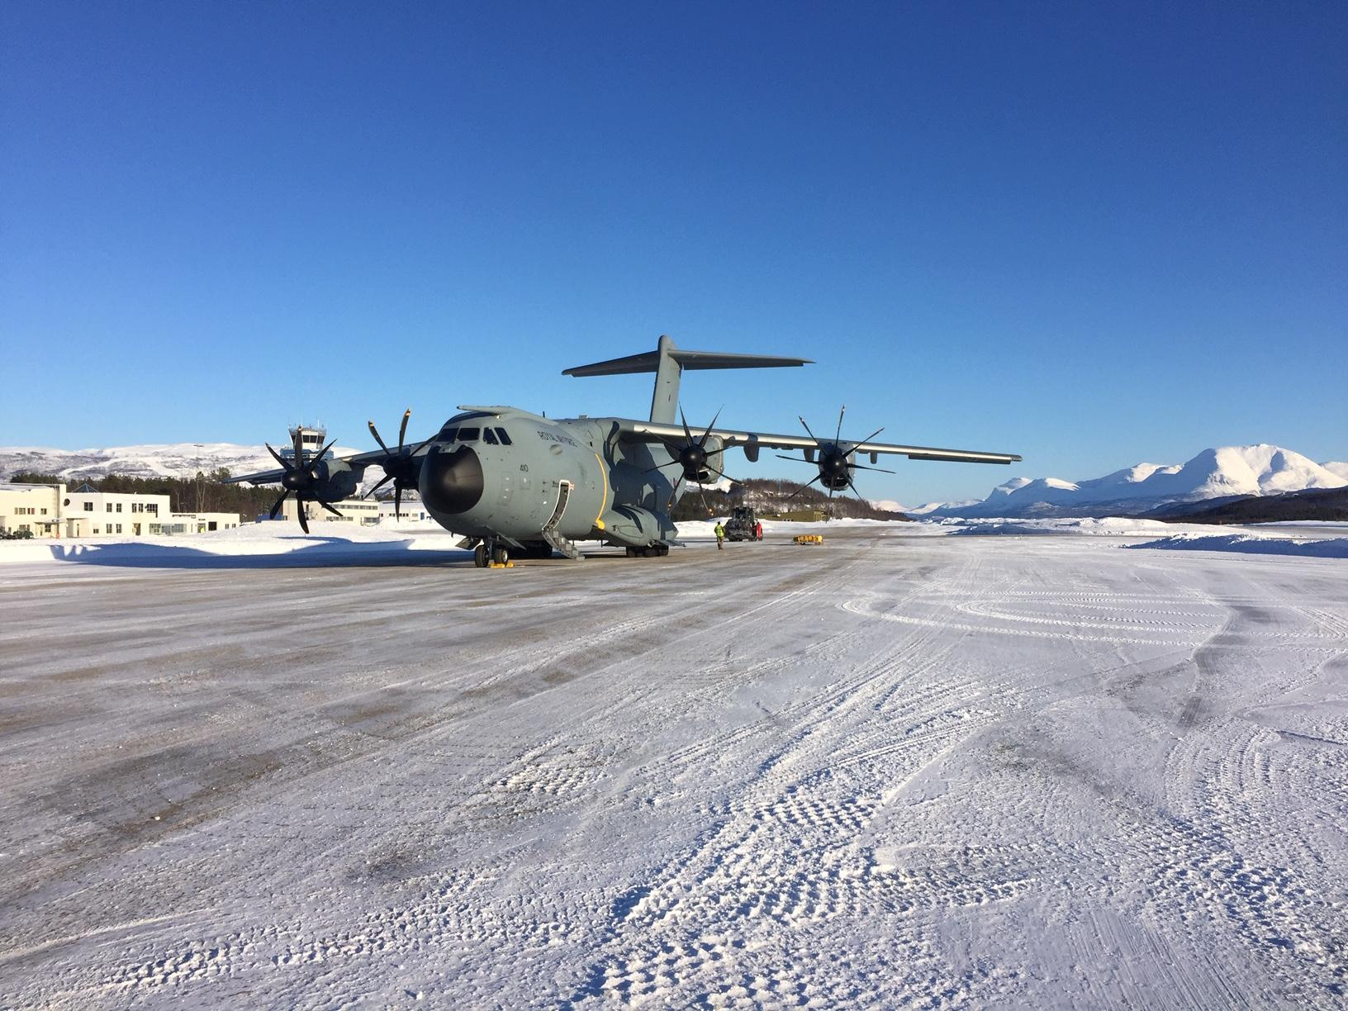
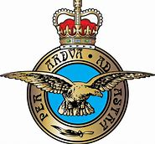
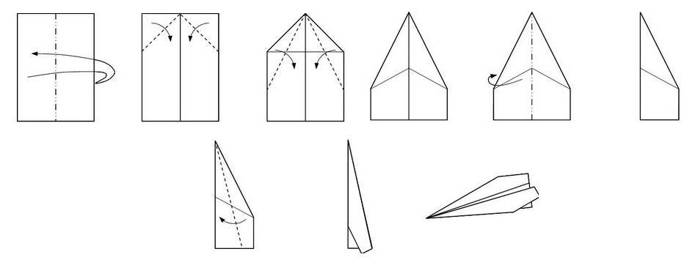
Aircraft Maintenance Engineer
We get aircraft ready to go on their next flight, this could be as simple as refueling to major repairs that takes months to complete.
We fly around the world fixing the aircraft wherever they land; staying in great hotels and enjoying the local culture.
You’ll need:
GCSEs
A Levels
Degree or Aircraft Maintenance licence issued by the Civil Aviation Authority (CAA).
Have a go!
Can you make a plane?
How far will it fly?

Slide 16
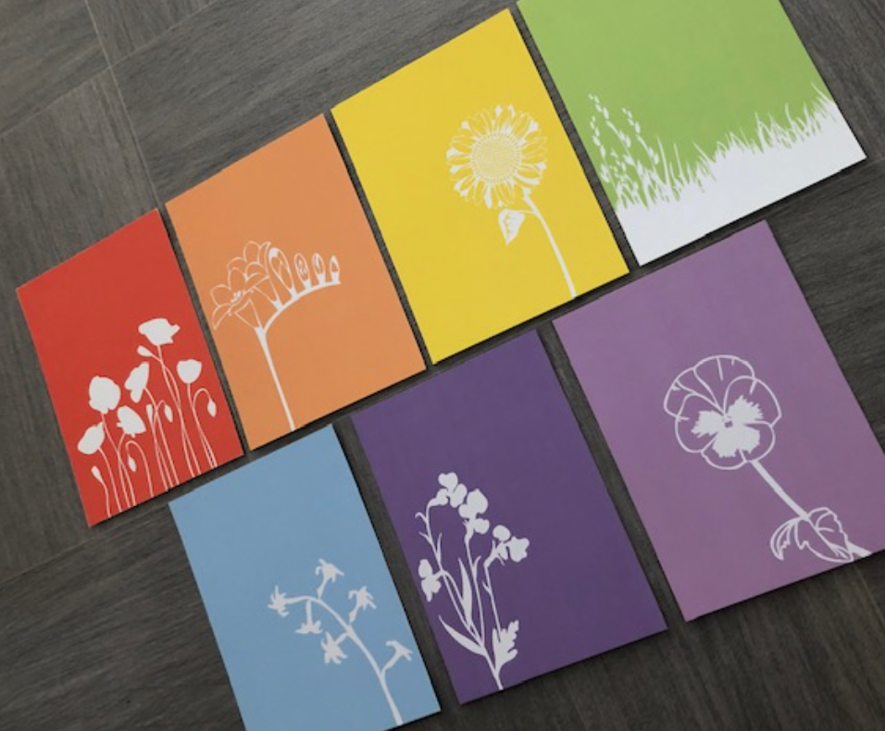
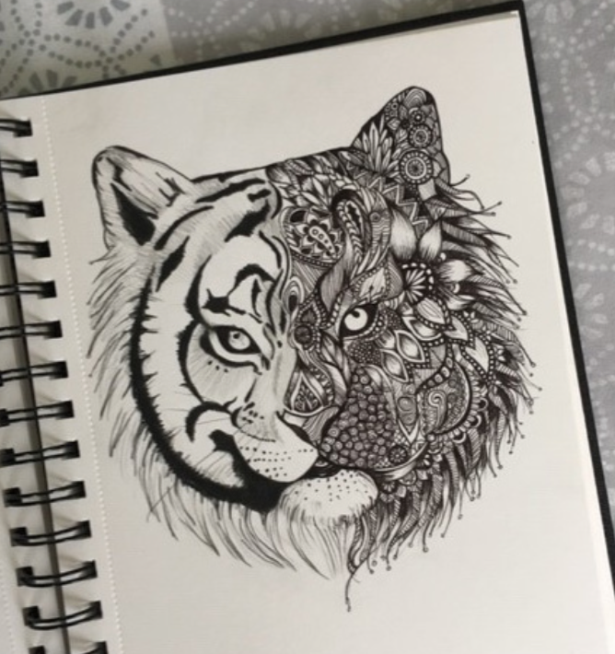

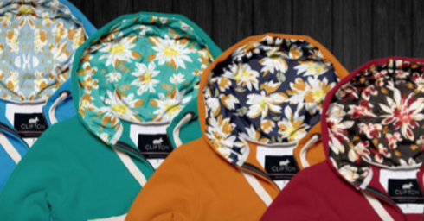
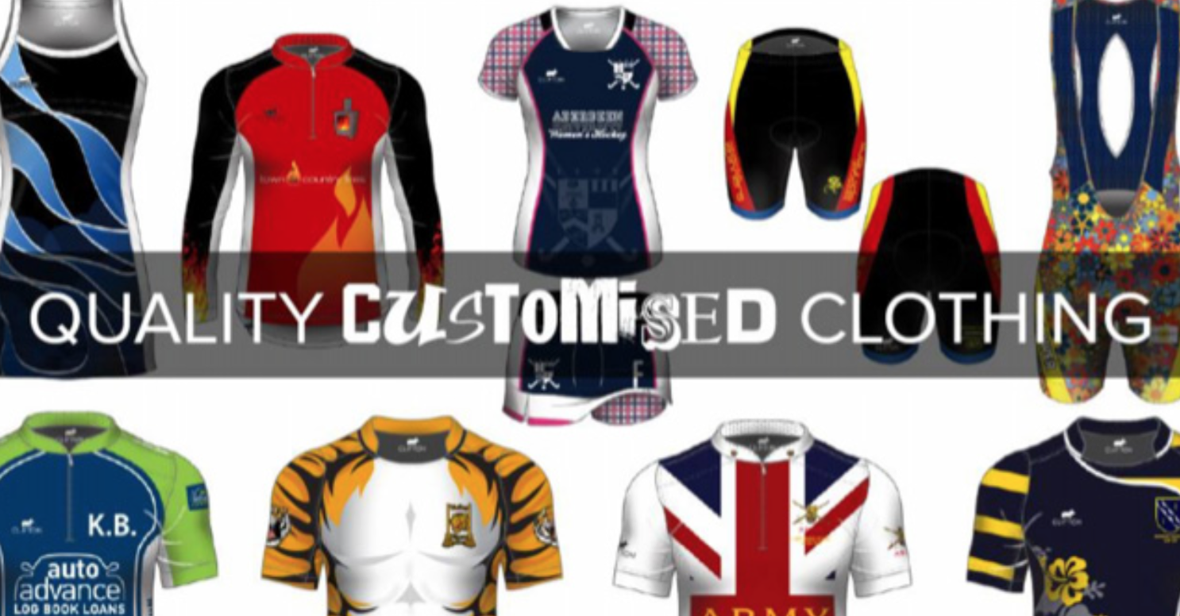


Graphic Design
The thing I love most about Graphic Design and Art is being able to be creative. In my spare time I enjoy drawing, and I am often commissioned by people to create Artwork. I have added some images of the work I have created.
After school/sixth form I went to college for a year to do a Foundation course in Art and Design. This allowed me to try lots of different options within Art, these included Graphic Design, Photography, Ceramics, Illustration and Fine Art. Once I sampled all of these I had to pick which one I wanted to do my Diploma in. I picked Graphic Design, as this interested me the most. I then went to University and got a degree in Graphic Design, where I learnt lots of different skills.
I worked in London for a Design company who make custom clothing and accessories. I used software such as Indesign, Illustrator and Photoshop to create unique one off pieces for customers. They would give me an idea of the things they would like, for example a colour scheme, any images they wanted on the clothing. Then I would create this for them.
My role included tasks such as-
Designing logos
Picking Fabrics and colours for the clothing
Creating layouts for the company website
Taking photos of the clothing
Drawing art work (either by hand or on the computer)
Task- Redesign your school logo, come up with a new and exciting design. I have added your current logo for reference.
Your design can look however you want, but you must use this colour scheme/palette

