Slide 1
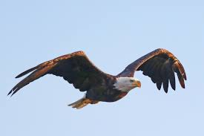
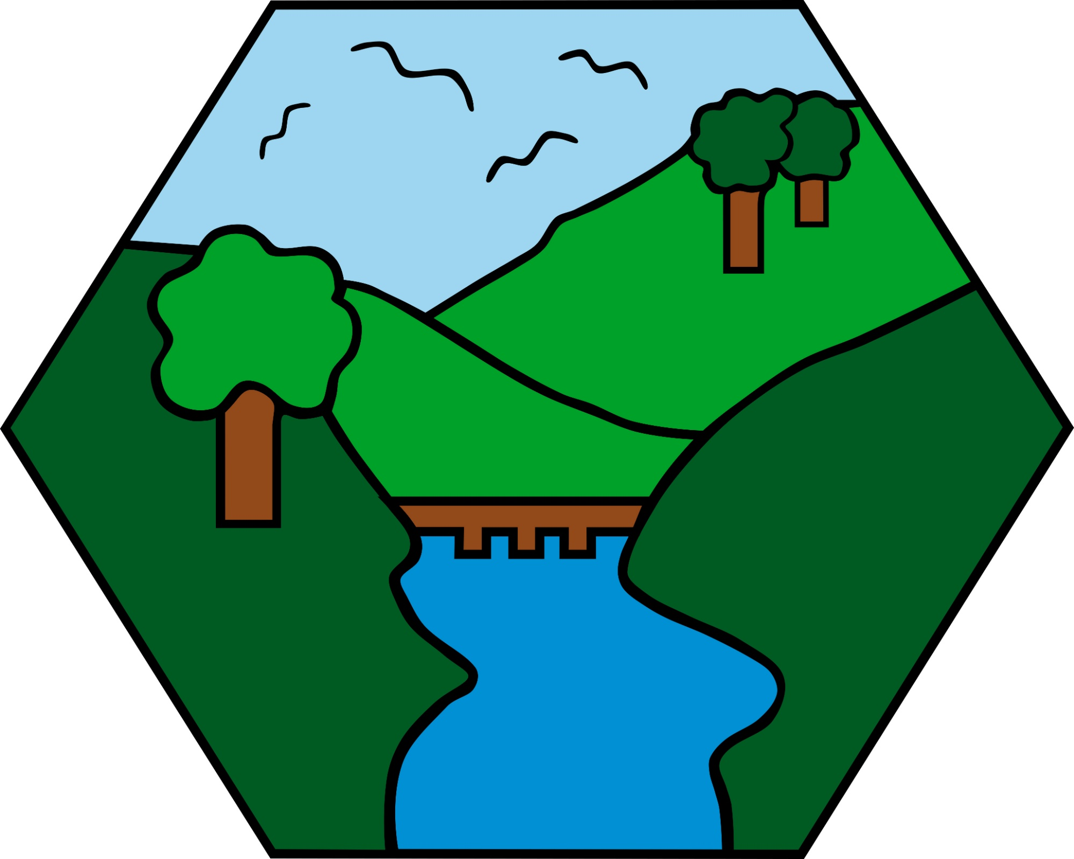
Year 6 Careers Week
The Future of Eagles
Part 2
Credit @primaryteachew

Slide 2
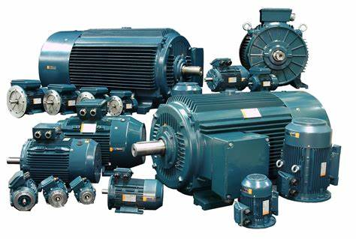
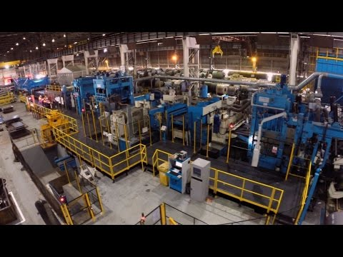
Electrical Engineer
What is it?
Electrical engineering is the design, building and maintenance of electrical control systems, machinery and equipment.
What makes it enjoyable?
It presents a different challenge every day.
It provides a sense of satisfaction when repairing or installing machinery and returning the customers plant back to working operation.
Activity:
Create a list of food companies that might use machinery that may need fixing.
https://www.youtube.com/watch?v=LAtPHANEfQo
What do we do?
We provide on site technical support at sites such as nuclear power stations, steel works, within the chemical industry and also provide technical support to food and beverage companies. We are instrumental in ensuring their production lines function correctly.
What does it take?
You will need GCSES in maths, science and English.
You can then complete an apprenticeship which is four years. Also working on site and attending college. This provides you with the technical qualifications.

Slide 3

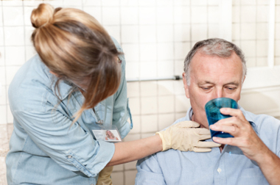
Speech and Language Therapist
What do speech and language therapists do?
Speech and language therapists diagnose, assess and treat babies, children and adults with communication and/or swallowing difficulties.
Our patients range from toddlers whose speech is slow to develop to older people who lose their ability to speak or swallow due to illness or injury.
Where we work:
Mostly within the NHS.
Settings include nurseries, schools, health centres, hospitals, prisons, youth offending institutes, visiting patients’ homes, charities.
How do you become a speech and language therapist?
GCSEs & A levels, preferably in related subjects (eg English, science, psychology)
4 year undergraduate degree or a 2 year postgraduate degree in Speech and Language Therapy
You would make a great Speech Therapist:
If you want to help people
If you are a good listener and communicator
If you enjoy English & science
If you enjoy working as part of a team
If you like a challenge
If you want a flexible job with lots of different opportunities
Task:
Try and communicate a message to someone without using any spoken words- experiment with all of the other ways you can
get your message across!

Slide 4
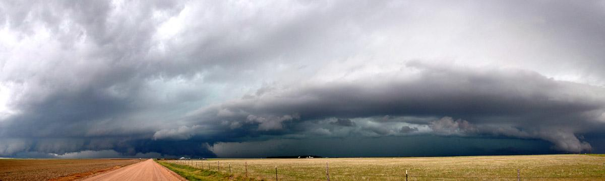
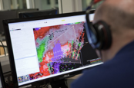
Research Meteorologist
Scientist Dr. Katie Wilson at the CIMMS / NOAA National Severe Storms Laboratory
What do I do?
Conduct experiments to test the impact of new technology on weather forecasters’ predictions of severe weather (e.g., tornadoes, giant hail, extreme flooding)
Explore research questions that have never been asked before
Attend conferences and workshops to learn about lots of other research happening in weather and climate
What qualifications do I have?
Maths (required), physics (required), and psychology (not required) A-levels
Highest degree is Doctor of Philosophy in Meteorology (and you oftentimes are PAID while completing this degree!)
What skills do I need?
Creative thinking and problem solving
Writing (for publications)
Computer programming/coding
Ability to communicate complex ideas in simple language to non-experts
Work well independently as well as in teams
A passion for discovering something new
What other professions can meteorologists work in?
Weather forecasting
Broadcast (TV)
Policy advisor
Insurance industry
Energy industry
Agricultural industry
Teaching
HUNDREDS of research areas (including storm chasing!)
And many more...
Click to watch this video about the National Severe Storms Laboratory: https://www.nssl.noaa.gov/about/
Links to Weather Activity Ideas: http://www.weatherwizkids.com/weather-experiments.htm and https://www.nssl.noaa.gov/education/students/

Slide 5

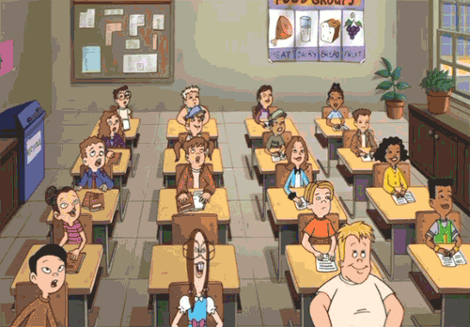
Teacher
To be a teacher you need to have either a teaching degree, or an undergraduate degree with a teaching top up (either through university - PGCE - or school based - SCITT).
This means you need to work hard at school to have GCSEs in Maths, English and Science as well as A-Levels...no matter what subject you want to teach!
The best parts of the job are:
The children!
It’s different every day
Chance to be creative
Working as a team
Make a real difference

Slide 6


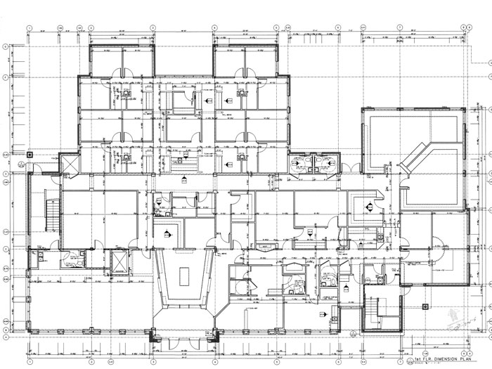
Quantity Surveyor
Best part about being a Quantity Surveyor is you don’t have to spend all day sat at a desk, there are opportunities to work on site, outside watching all the action whilst doing your job.
What is a Quantity Surveyor?
Quantity Surveyors are responsible for calculating and managing the costs of a project to keep it under budget and not over spend. We deal with construction companies, public, train operating companies, housing developers...the list is endless.
How can you become a QS
Work hard at school
Do your A Levels - maths is useful
You can either go on to an apprenticeship scheme with an employer or go to uni and study for 3 years.

Slide 7
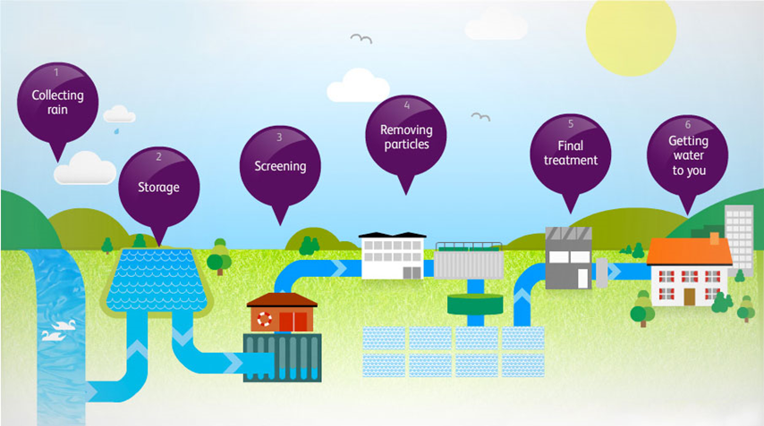
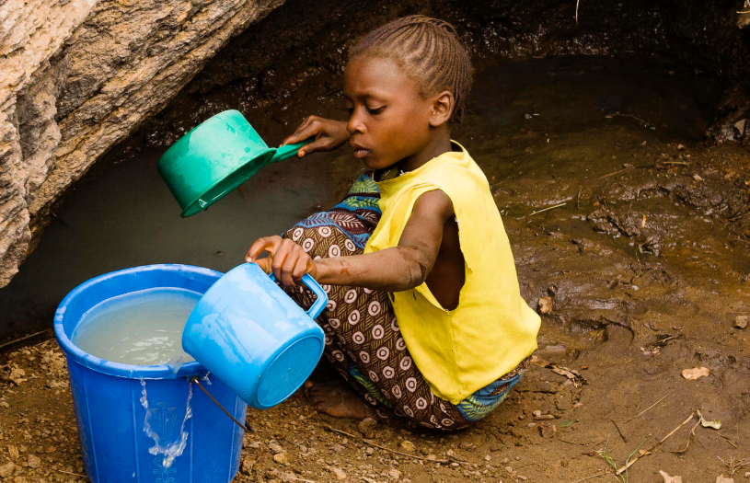



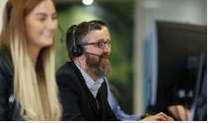
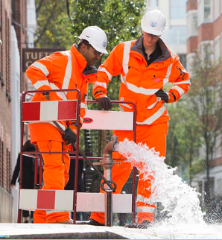
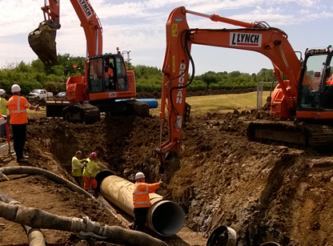
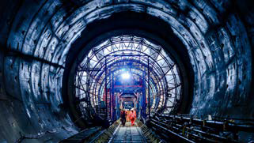
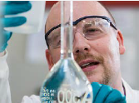
Water and Sewage Industry
Would you do this everyday before school?
So you could drink this?
So you could drink this?
Or would you rather turn this on?
Jobs you could do - or try different ones during your career!
Office Teams
Speak to customers
Plan out work for field teams
Design new pipes for new housing projects
Move water remotely using automatic systems
Be a People Manager!
Field Technician
Problem solving
Stopping leaks
Civil Engineer
Fix broken pipes
Or build huge tunnels under the River Thames!
Scientist
Doing experiments to check water is always safe to drink
Start with good GCSEs in a wide range of subjects and see what you can do.
We also offer programmes for graduates.

Slide 8
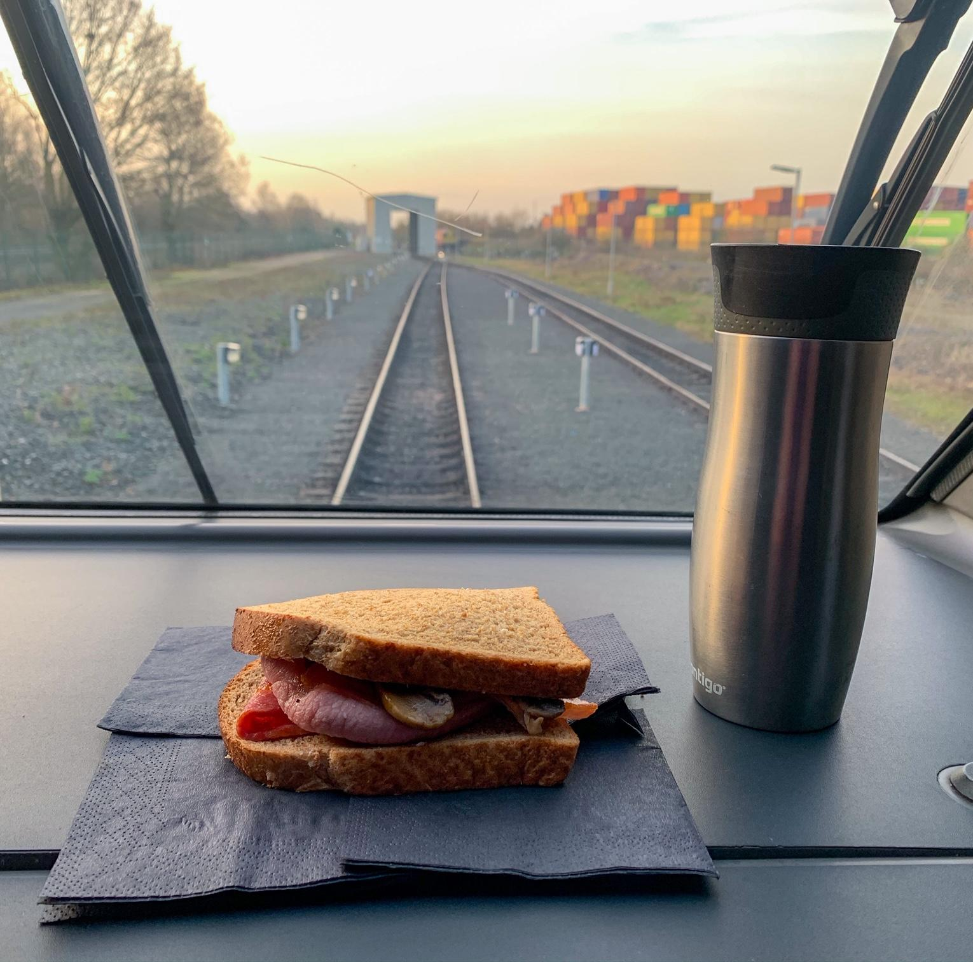
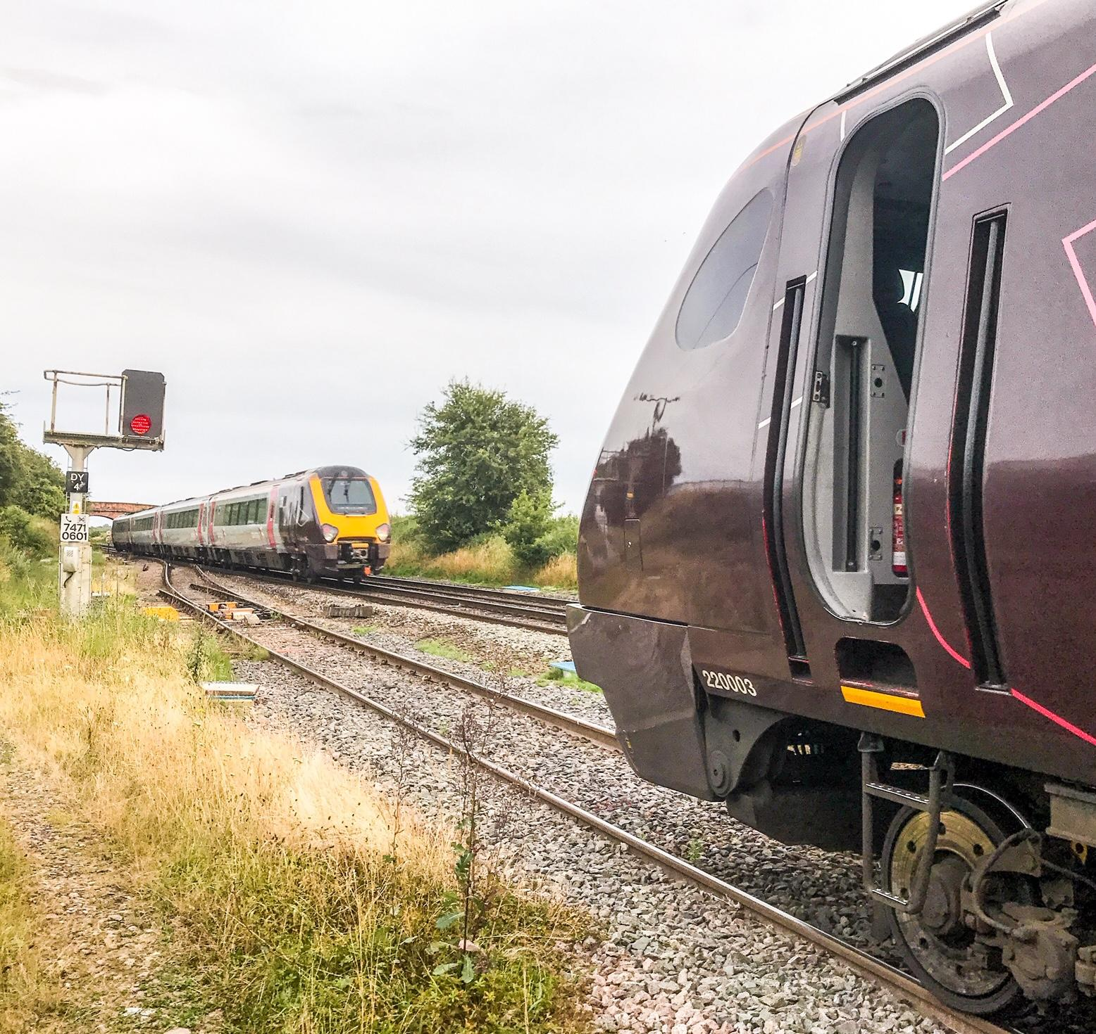
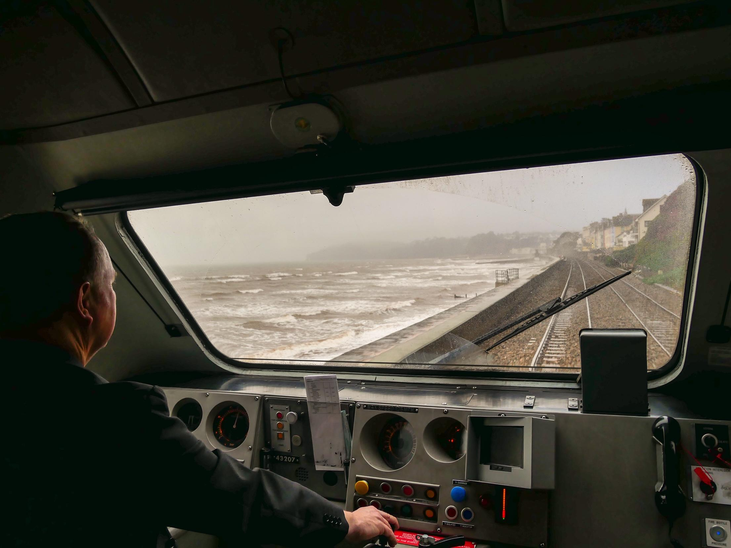
High Speed Train Driver
As a train driver with CrossCountry, I drive long distance passenger trains around the country at speeds of up to 125 mph. Train drivers for other companies might drive freight trains or commuter trains so there’s plenty of variety.
My first job on the railway was as an office clerk and then I moved on to train driving. Many train drivers started off this way, or as catering staff, guards or working on stations; most companies choose their trainee drivers internally.
The training took 15 months. You have to learn all the rules, the routes and some technical knowledge about the trains in case they break down so you can do the job safely,
Everyday is different
Working with great people.
Best Bits.
Having a job I don’t take home with me.
Seeing the countryside in all weathers and seasons.
Worst Bit
Shift work - 3am alarm calls aren’t for everyone
,

Slide 9

Environmental Health Practitioner (Officer)
What's good about the job?
You use science and legal skills. You give advice, do inspections and also take prosecution if laws we enforce are broken.
You work out of the office a lot!
You can work for a Local Authority, The Government, a private business, a charity and even in another country like Australia ,
What’s not so good ?- you won't make a fortune in public service.
You do a specific degree at university to be registered as an EHP with practical training placement too
https://www.cieh.org/what-is-environmental-health/
This is an old job - it started in 1844 when the country was in the middle of a pandemic of a disease called Cholera.
Our name has changed over the years but a lot of the job is the same.
We have lots of different special knowledge some people work in just one area.
We do: Food Hygiene +standards,Health & Safety at work, Pollution + Noise & other nuisances, Housing standards, Infectious disease control with public Health Doctors

Slide 10

Working Adult in Social Care
I work as a Case Co-ordinator alongside Social Workers for the local Council. My role is simply to find out if people are able to live their day to day lives independently and safely. If a person is unable to manage my job is really about finding out why they are unable to cope with certain tasks by themselves and see if we can help them
My job is very interesting because we meet all sorts of people and they all have different problems, the trick is to help them to regain their independence. So what do you need to do my job? Good GCSE grades, as report writing and budgeting is involved, as well as enjoying being with people and having a desire to help them.

Slide 11
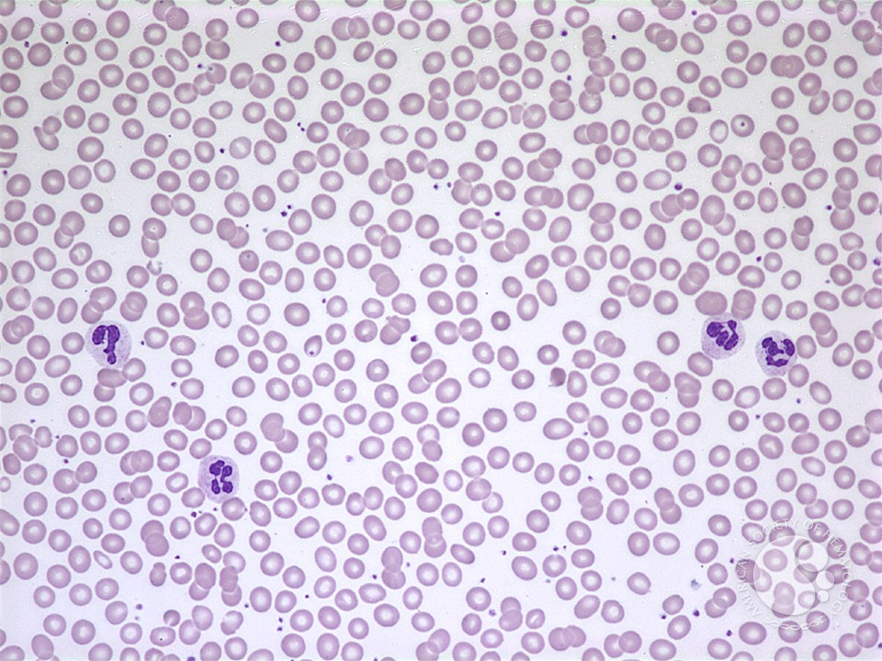
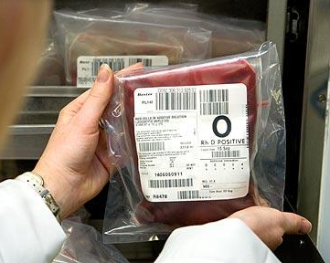


Biomedical Scientist
My job is really interesting, and working in transfusion can be very exciting when there is an emergency!
My favourite thing about the job is knowing that I am playing an important role in patient care, and helping save lives.
Working at night can be tiring, but I enjoy the variety of working different shifts.
There are lots of different types of biomedical scientist, but I work in haematology and transfusion.
I work in a hospital laboratory, running tests on patient blood samples to help find out what is wrong with them. We use machines and microscopes to count the different types of blood cells, and we can do tests to see if blood is clotting properly, too.
In the transfusion lab we do tests to find out what blood group people are, so we can match them with the right blood.
Our lab operates 24/7, so sometimes I have to work evenings, nights, and weekends.
My background:
I always enjoyed science at school and chose to study Biomedical Science at university. My degree included a training placement in a hospital, where I collected the evidence I needed to complete my registration.
Task:
Can you find out what the main blood groups are?
What type of blood can be given to anyone?

Slide 12

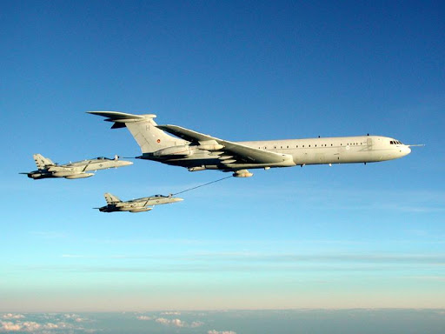
Loadmaster
My job was part of the Royal Air Force (RAF). I had to ensure the aircraft was loaded safely to enable it to fly in a balanced condition. The cargo we carried also had to be checked that it met safety regulations. My job took me all around the world! Once, I went round the whole world in one trip which took 10 days!
We carried cargo like:
Vehicles
People
Explosives
Spare parts
The two types of plane I flew on were a Hercules and VC10.
We also did air-to-air refueling (putting aviation fuel into another plane WHILE WE FLEW!) as well as carrying out Fighter AFIL. This was where fighter jets had to pretend to attack us and we had to evade them! A bit like role play.
You’d like this job if you:
Enjoy solving problems
Like visiting different places
Can work well as part of a team
Must enjoy flying!

Slide 13

HR Advisor
To become a HR Advisor, you need to do a CIPD to make sure you have the right skill set. There are different routes into the job but it helps if you work hard at school as you will need some qualifications (it helps to have maths and English). You also need to communicate really well!
I work as a HR Advisor within the NHS. My job role has lots of different responsibilities to help the company run well, but the main ones are:
Employee relations (such as disciplinaries, grievances and performance management).
Sickness Absence Management
Monitor Recruitment
Create reports for who leaves, staff numbers etc.
I really enjoy dealing with people at all levels within the organisation.
Activity:
We have to write letters! Could you write a formal letter inviting an employee to an important meeting with their manager?
Remember, it needs to use formal language, include a date and time as well as sound professional.

Slide 14

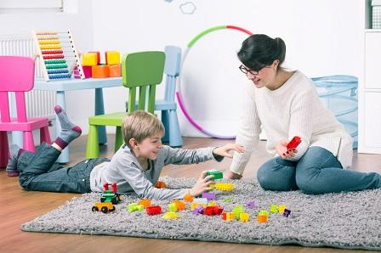
Play therapist
What training would I need?
Play therapists are specifically trained with a postgraduate course in play therapy. During this training, a play therapist is taught about children’s development.
What is it?
In a safe, caring and confidential environment, the child is able to choose whether or not to play with as little or as many of the toys available as he/she wants to. There are few opportunities for children to have real freedom to play without constraint. Play is a vital part of a child’s life, it is essential for them to develop physically, emotionally and socially. Children also often express themselves or their feelings better through play as it fosters imagination and creativity whilst encouraging their concentration and confidence. Play helps a child to learn that ‘feeling’ is OK and helps them to cope with these feelings.
Tool kit
Role play
Puppets and masks
Sand tray
Art materials
Music
Dance and movement
Clay
What makes it enjoyable?
Building therapeutic relationships with children
Seeing children become more aware of their feelings/emotions, learning to accept them and developing successful strategies to deal with them in the ‘real world’

Slide 15
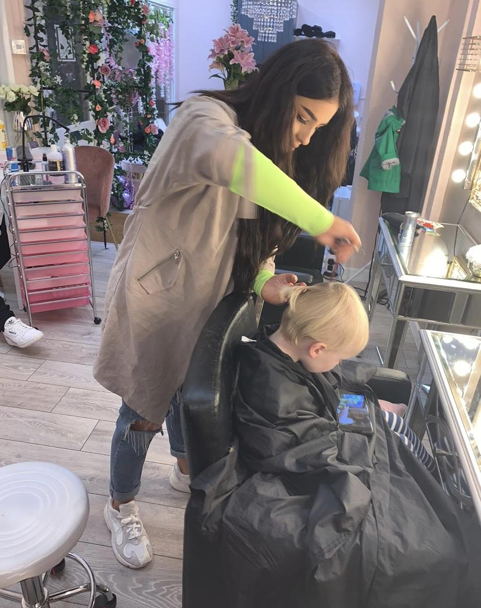
Hairstylist
How do I become a Hairstylist?
To become a hairstylist you need good GCSE’s, strong legs to be able to stand up all day, a steady hand and good people skills.
Hair qualifications can be achieved at college or as an apprenticeship in a hair salon, where you will achieve a level 2 or 3 NVQ in hairdressing.
What do I do?
My job is to make people feel good about themselves! In a normal day I am usually cutting hair, colouring hair as well as adding different types of hair extensions to make my clients look like a real life princess. Every now I then I get to do hair for weddings or special occasions, which I love to do!
Hair extensions can be applied using little beads, a needle and thread, glue or sticky tape. Everyone needs different methods depending on their hair types.
Where can I work as a hairstylist?
As a hairstylist you are able to work in salons, open your own salon or work as a freelance hairstylist, where you are able to travel to studios or people’s homes in order to do their hair.

Slide 16
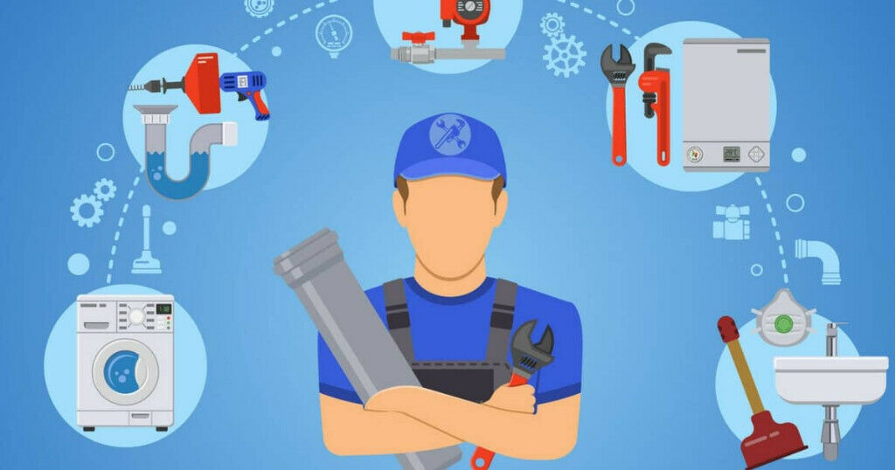
Plumbing and Heating Engineer
What is this?
This role is a fundamental part of everyday life. Engineers install boilers to heat the home and provide hot water. Once this is done, they must be checked according to safety guidelines yearly for any defects. Alongside this, they can design and fit new bathroom suites, fix leaks within the home and install gas hobs and fires.
How do you become one?
To get started, you need to complete an NVQ Level 2 in Core Plumbing which leads to an NVQ Level 3 at a more advanced level. During this time, you will be employed by a relevant company who will support you with an apprenticeship - this is invaluable as you will learn many practical skills in a variety of environments.
Once you have qualified, you can work for different companies that range from small family run businesses to larger companies which provide heating for new housing estates. Heating engineers are always in demand so you may even want to set up your own business!
Reasons to consider this job:
Job stability
Opportunities to master the craft and work your up
Job satisfaction - knowing you’ve helped someone in need
Social interaction - being around others and offering good customer service with a friendly smile!
Other opportunities it can lead to:
I have been a heating engineer since leaving school and I am now a Site Manager for a new housing estate. This means I no longer do as much practical work, but I inspect the work of others and manage a team to ensure things are completed correctly and on time.

Slide 17


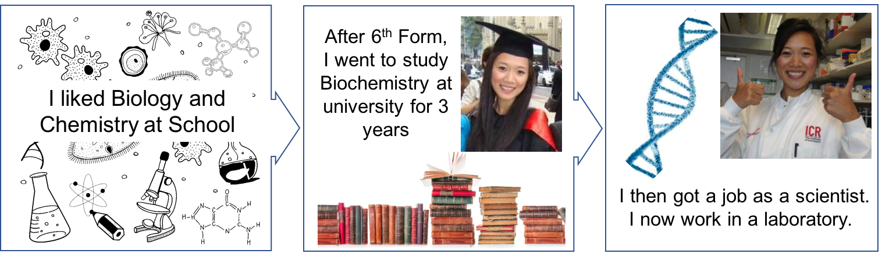
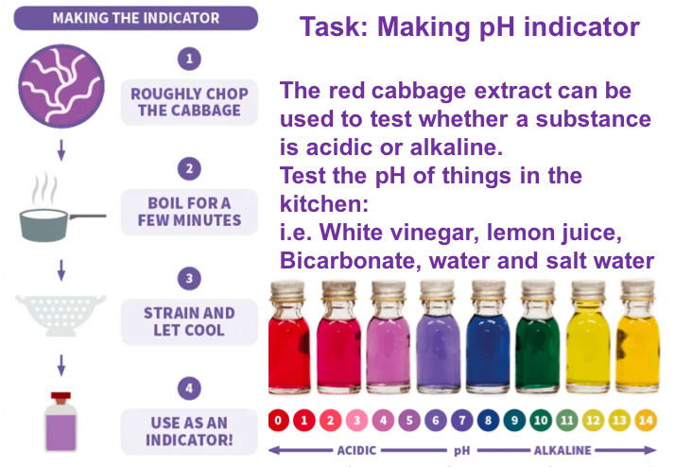

Jane and Patty - We Are Scientists!
Jane: After school I went to university to study Neuroscience. This is a special type of Biology where you learn about the brain.
Afterwards, I did another degree called a PhD where I did research in a laboratory. My research was about pain. Pain is important for humans because if we hurt ourselves, it reminds us to be careful and protect the area which is hurt. You wouldn’t want to walk around with a broken leg! Sometimes however, pain isn’t helpful and we need to take medicine to make it better. My job was trying to find a way to make new painkillers to help this!
Task: A few people in the world are born with a very rare problem – they cannot feel pain! Scientists work with them to understand why this has happened and
to understand more about pain. Can you
think of what might happen if you couldn’t
feel pain?
The best bits about my job:
Knowing that one day, my work will help people!
Working with scientists from all around the world.
Learning new things all the time.
Getting to invent exciting new experiments.
What else can scientists do?
Scientists work on all sorts of topics, such as Alzheimer’s disease, diabetes or cancer. Being a scientist requires hard work but it is great fun! It’s especially interesting if you are curious about how the body works or want to know more about science topics you might see in the news.
Patty: I’m a Cancer Researcher
Why do I enjoy my job?
* I can do something different everyday
* I learn new skills and experiments
* I don’t have to sit at a desk all day
* I work with people from all around the world
* I think it’s exciting that we can make new discoveries
* We make discoveries that can lead to new treatments
*
What do I do?
My job is to understand how faults in our genes can cause cancers to grow.
I look at how we can target these genetic faults to find new treatments to cure patients with the disease

Slide 18
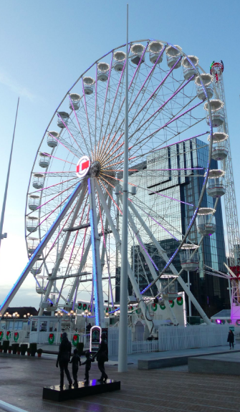
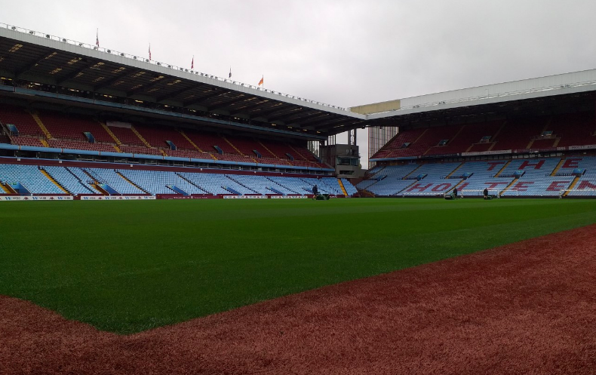
Alex - Corporate Parenting Coordinator
What I do in my role?
A big part of my role is working with organisations, businesses and groups to create partnerships to support children, young people and adults in Birmingham.
This can be very exciting as we work with organisations such as Aston Villa FC, Birmingham City FC, Edgbaston Cricket, Ice Skate Birmingham, Birmingham Airport and Barclays to name a few. We get to meet great people and visit great places!
Best bits
One of my highlights was as a team, organising and running an event for over 1,000 children, young people and families to go and ice skate, ride the big wheel and socialise around Christmas time!
How I got here?
After A Levels, I studied Sport and Leisure, Psychology and Education at University for 3 years; after this I knew I wanted to work in education and more importantly, with young people. Although my university degree wasn’t in this field, it encouraged me to work hard to reach my goals. I went from being a learning mentor to working in the local authority at Birmingham Children’s Trust and I am proud to be part of #bhamsbiggestfamily.
To get here you need your GCSEs and experience with young people; whether this is through college or university degrees. You will also need an understanding of the local authority, policies and procedures.
Task - Think of an organisation/business in a certain sector i.e. sports, food, technology; what do they offer/sale? What skills might their staff have? How could this benefit young people i.e. work experience, activity sessions, life skills.
Design 6 activities with your chosen organisation that would directly benefit young people and/or give them a memorable experience!

