Slide 1
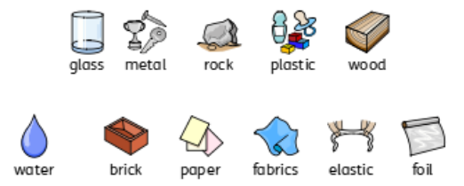
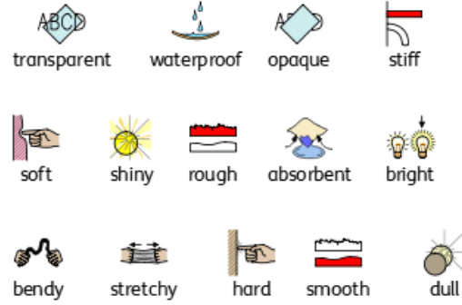
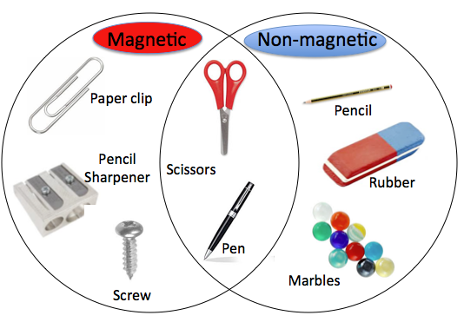
Everyday Materials
Science Y1 - Autumn
Big Question:
‘Are all materials solid?’
What I will know by the end of the unit:
I can distinguish between an object and the material it is made from. I can identify and name a variety of everyday materials.
I can describe the physical properties of a variety of everyday materials.
I can compare and group together a variety of everyday materials based on their simple physical properties.

Slide 2
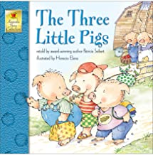
Everyday Materials
Science Y1 - Autumn
Big Question:
‘Are all materials solid?’
Key Vocabulary
Absorbent | A material that soaks up liquid.
Bendy | An object that bends easily into a curve.
Dull | Something that is not bright.
Elastic | A material that stretches when you pull it and returns to its original size and shape when you let go.
Magnetic | A material that is attracted (drawn closer) towards a magnet.
Non-magnetic | A material that isn’t attracted (drawn closer) towards a magnet.
Material | What an object is made out of.
Object | A thing that can be seen and touched.
Opaque | An object or substance that you cannot see through.
Properties | A way to describe a material.
Rough | Uneven and not smooth.
Shiny | Things are bright and reflect light.
Smooth | No roughness, lumps or holes.
Soft | Not rough or hard.
Rigid | Firm and does not bend.
Stretchy | Slightly elastic.
Transparent | Something you can see through.
waterproof | A material that does not letter water pass through.
Curriculum links
The unit builds on the work describing objects in YR and will provide the foundation for Y2 when they describe in more detail how materials change and uses of different materials. Materials in covered at a much deeper level again in Y5 Materials investigations are linked to the current topic of the class.
Famous Scientists and books
Charles Macintosh – invented waterproof material used in rain coats. The three little pigs story links to one of our investigations on materials and their properties.
Investigate!
How are objects similar/ different based on the materials they are made from? ‘We’re going on a materials hunt’ – How many materials can you find? What is the best material to fix Mrs. Boyd’s umbrella? What material is the best for making a house for the three little pigs? How can I help my lego-man escape from the ice-berg?

