Slide 1
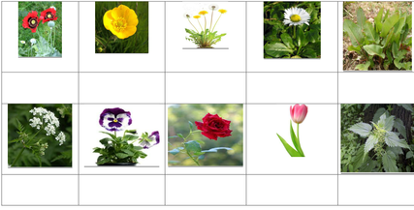
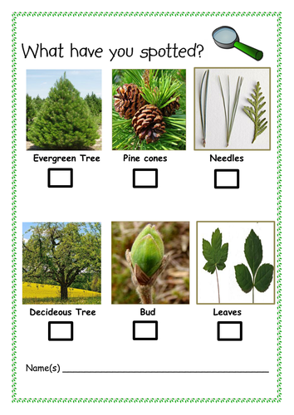
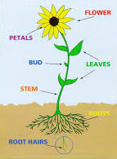
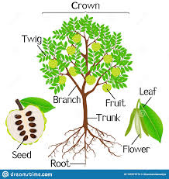
Plants
Science Year 1 - Summer
Big question:
‘Is a tree a plant?’
What I will know by the end of the unit:
I can name a variety of common wild and garden plants.
I know the difference between deciduous and evergreen trees. | Deciduous trees lose their leaves in the Autumn and grows new leaves in the Spring. | An evergreen tree keeps its leaves all year round.
I can name and label the basic parts of a flowering plant. I can name the basic parts of a tree
Poppy
Buttercup
Dandelion
Daisy
Doc leaf
Cow parsley
Pansy
Rose
Tulip
Stinging nettle

Slide 2
Plants
Science Year 1 - Summer
Big question:
‘Is a tree a plant?’
Key Vocabulary
Deciduous Evergreen Trunk Branch Bark Leaf Root Bud Flowers Blossom Petals Stem
Curriculum links
Work on seasonal changes carried out at the end of each term. This follows on from the work carried out in reception when they grew beans and observed how fruit decayed over time. This will provide a foundation for the plants topic carried in Y2
Famous Scientists
John Ray – One of the firsts people to classify plants. Carl Linnaeus – Most famous Botanist.
Investigate!
Plant this seed. What do you think it will grow in to? Lets water it, watch it grow and record the changes in a diary. How many different plants can you name? Lets go on a welly walk and see how many different plants we can find. Lets collects some plant samples. Can you name and label the key parts? Look at these two plants. How are they the same and how are they different? Skills: Observing closely, using simple equipment, identifying and classifying, gathering and recording data to help in answering questions.

