Slide 1
The functions of the skeleton
Shape – The skeleton gives us our shape & determines our size.
Support – The skeleton supports muscles and organs.
Protection – The skeleton protects delicate parts of the body like the brain and lungs.
Movement – The skeleton allows us to move. Muscles are attached to the bones and move them as levers.
Blood cell production – blood cells are made in the bone marrow.

Slide 2
Bones in the body
Skull | Jaw bone | Ulna | Vertebrae
Clavicle | Phalanges | Pelvis | Tibia
Metacarpals | Carpals | Femur | Patella
Sternum | Ribs | Fibula | Metatarsals
Humerus | Radius | Tarsals | Phalanges

Slide 3
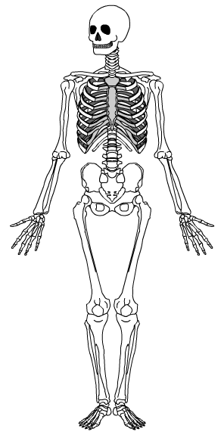
The Skeleton
Cranium (skull)
Clavicle (collar bone)
Sternum (breast bone)
Ribs
Humerus
Vertebrae
Radius
Pelvis (Hip)
Ulna
Patella (knee cap)
Femur
Tibia
Fibula

Slide 4
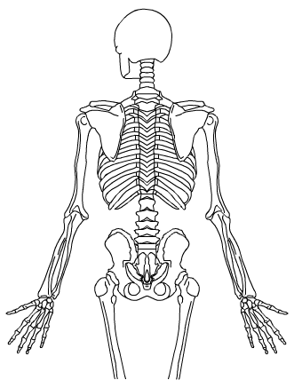
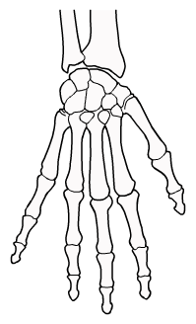
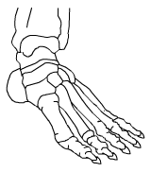
In detail
Scapula (shoulder blade)
HAND
Vertebral column (spine)
Carpals
Metacarpals
FOOT
Tarsals
Metatarsals
Phalanges
Phalanges

Slide 5
Types of bones
LONG BONES | SHORT BONES | FLAT BONES | IRREGULAR BONES
Long in size Act as levers | Light Strong | Protection of delicate areas Areas of muscle attachment | Specially shaped for a particular function
Femur (leg) | Tarsals | Cranium | Patella

