Slide 1

VE Day 8th May 2020

Slide 2
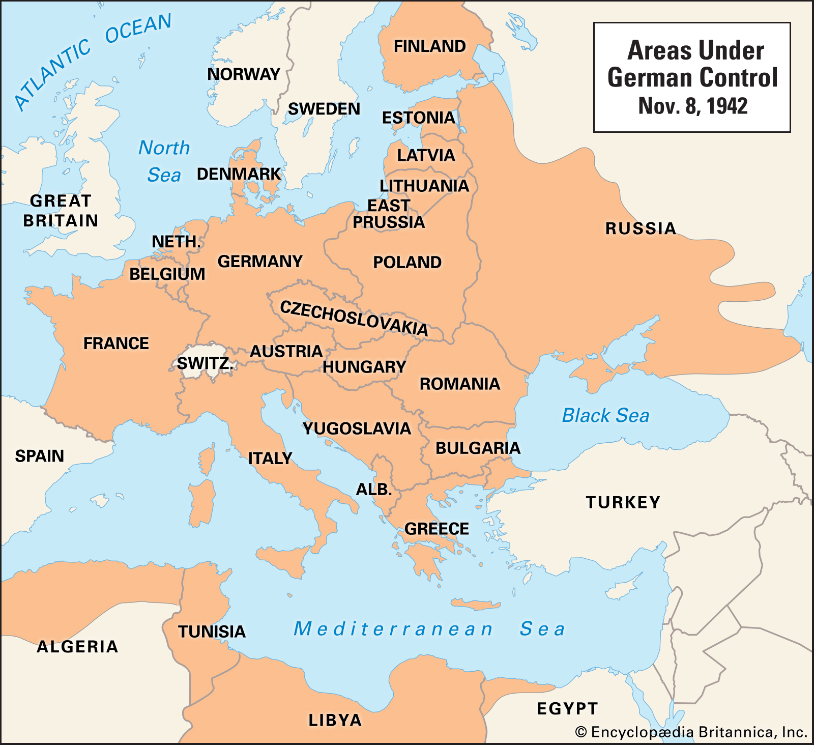
What is VE Day?
VE day is Victory in Europe Day.
It celebrates the end of the Second World War in Europe, when Adolf Hitler was finally defeated.
The war continued against Japan until August 15th.
It brought to an end six years of fighting against Germany and its allies.
In the process of the victory the allies liberated 20 countries that had been conquered by Germany including Poland, Czechoslovakia, France, Holland and Belgium.

Slide 3
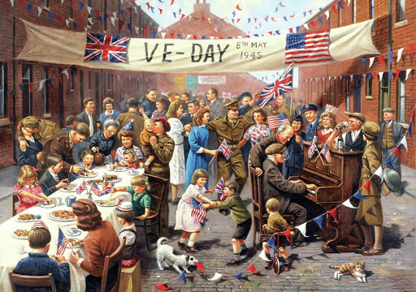
VE Day – 8th May 1945
On the morning of 8 May 1945, a national holiday for ‘Victory in Europe Day’ was declared in Britain,
Prime Minister Churchill had gained assurances from the Ministry of Food that there were enough beer supplies in the capital
The Board of Trade announced that people could purchase red, white and blue bunting without using ration coupons. Street parties were held across Britain with bunting lining the streets.

Slide 4
Have a look at the pictures on the next few pages.
What do you notice about the people?
Why do you think the photographs are all in black and white?
How do you think the people felt?
Would you have liked to be part of a street party? Explain your answer.
How can you tell that it is VE day in LS Lowry’s painting?

Slide 5
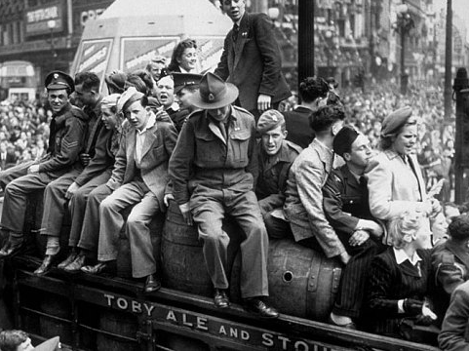
VE Day in London as pictured by the Daily Telegraph

Slide 6
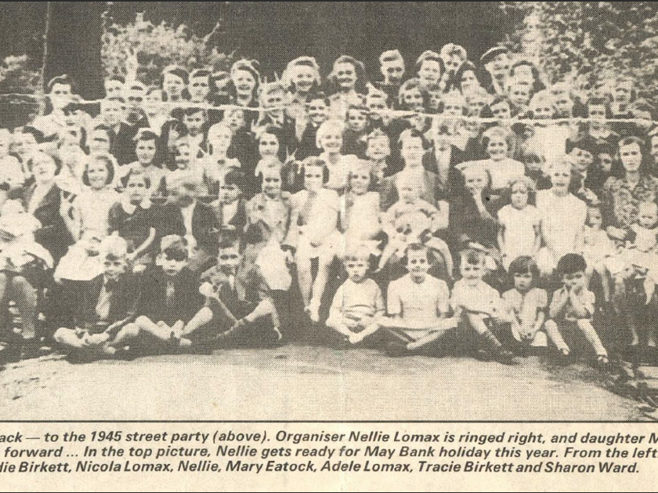
A street party 1945

Slide 7
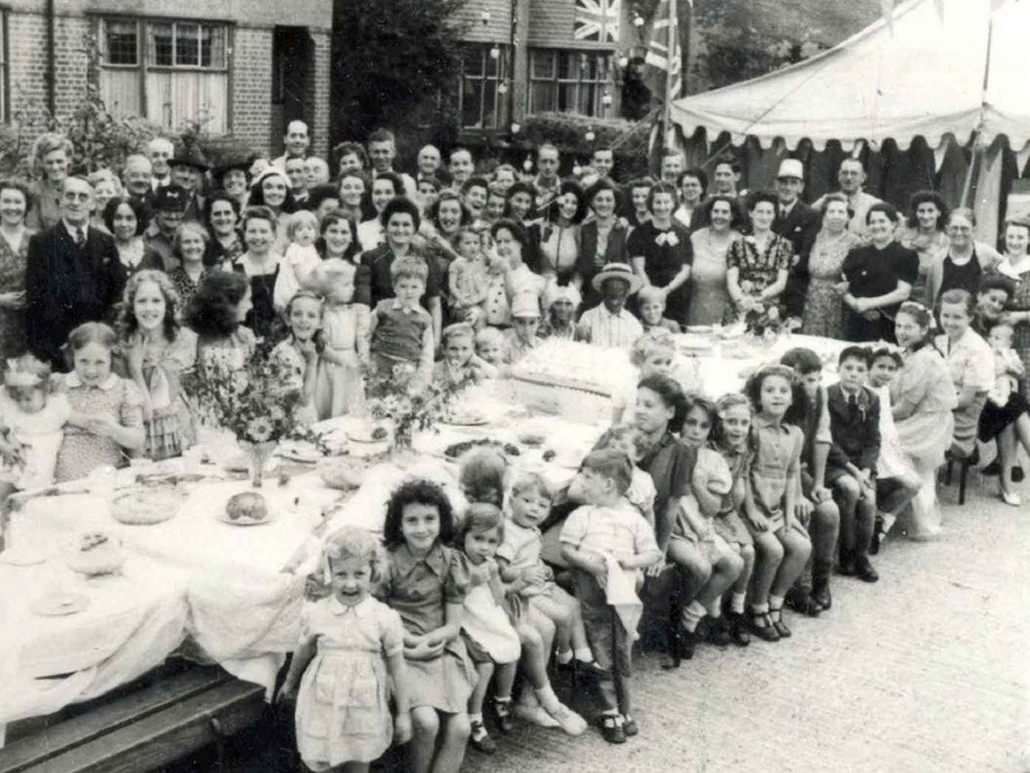
VE Day party in 1945

Slide 8
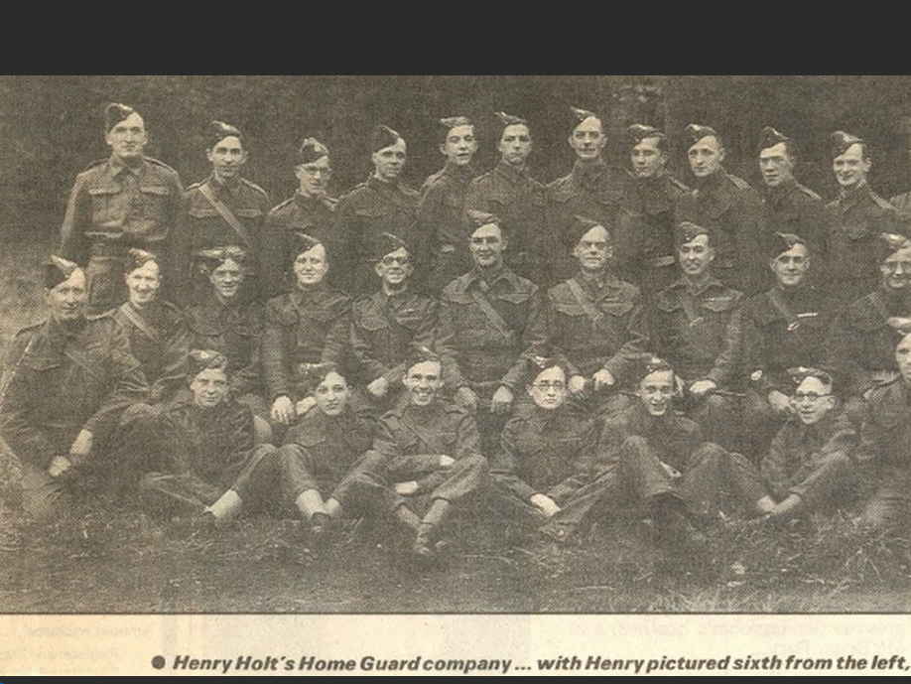
Home Guard preparing to celebrate VE Day

Slide 9
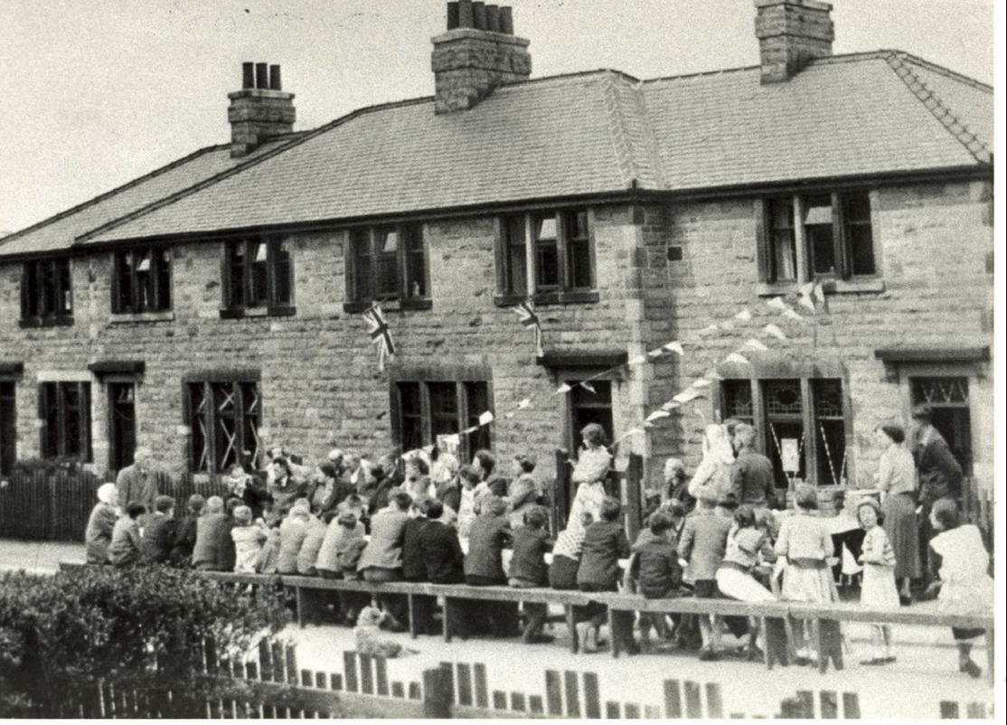
VE Day Street party 1945

Slide 10
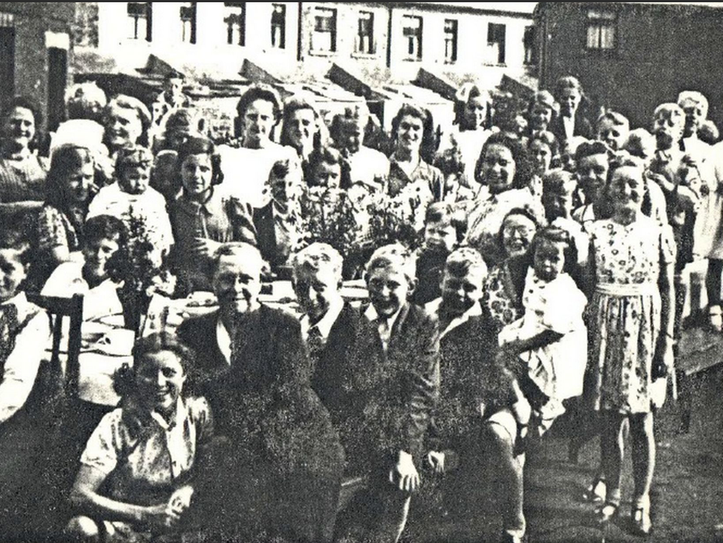
VE Day in 1945- street party

Slide 11
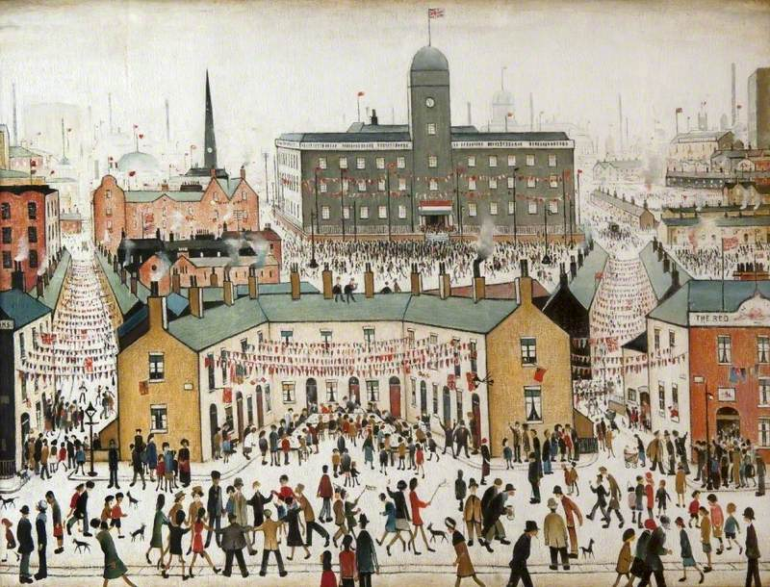
LS Lowry’s painting of life on VE Day in Manchester

Slide 12
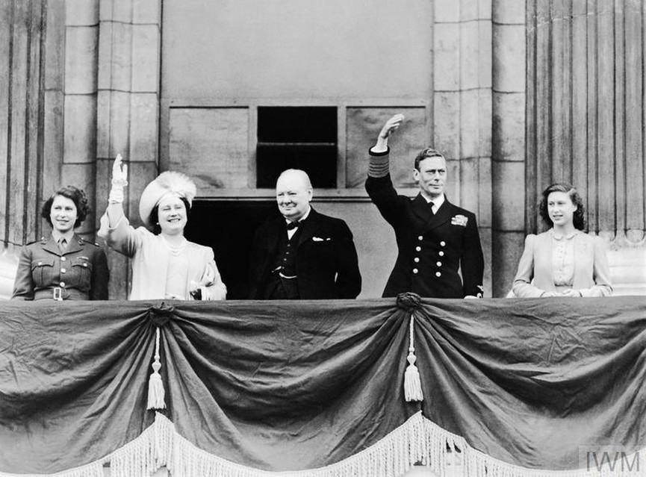
British Royal Family celebrate
Huge numbers of people turned out to see King George VI, Queen Elizabeth and their daughters, Princess Elizabeth and Princess Margaret, as they appeared on the balcony at Buckingham Palace. .
In total, the King and Queen made eight appearances on the balcony, and at one point were joined by Winston Churchill.
The future queen, Princess Elizabeth, and her sister Margaret had been allowed to leave the palace and take part – anonymously – in the party-like atmosphere. Princess Elizabeth later recalled, 'We stood outside and shouted, "We want the King"… I think it was one of the most memorable nights of my life.'

Slide 13
British Royal Family celebrate
Where did the British Royal Family appear?
How many times did they appear?
Who is the man in the middle of the photographs?
Why do you think Queen Elizabeth describes the evening of VE day ‘as it was one of the most memorable nights of my life.’
Do you think today’s princes or princesses would be allowed to go out and celebrate in crowded streets in London on their own? Explain your answer.

Slide 14
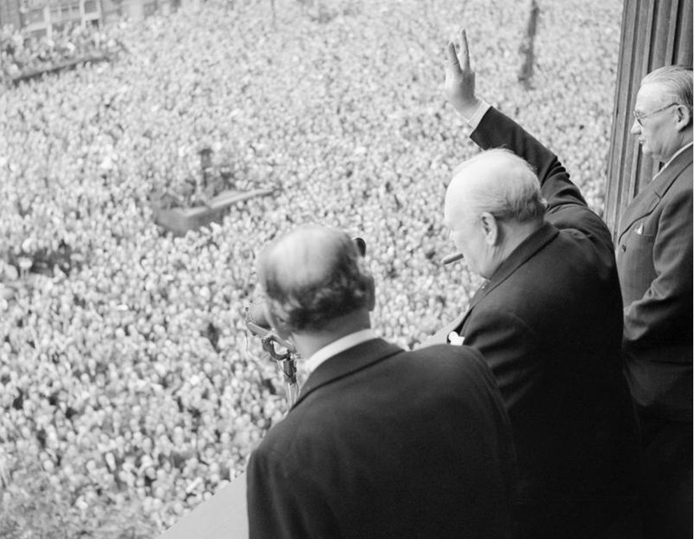
The Prime Minister addresses the nation
At 3pm on VE Day, Winston Churchill announced the welcome news that the war had ended in Europe – although he warned the war hadn’t ended – Japan fought on.
Later on, Churchill appeared on a balcony in London. Huge, cheering crowds heard him declare, 'This is your victory.’ The crowd shouted back, 'No – it's yours!’
Despite Churchill’s crucial wartime role, he lost the general election in July 1945. For Churchill, nothing would match his period as wartime prime minister – he later wrote that everything afterwards was 'all anti-climax'.

Slide 15
The Prime Minister addresses the nation
Who was the Prime Minister?
When did he address the nation?
What did he warn?
Explain how you know that the British people might have appreciated what Winston Churchill had done?
Explain how you know that the British people might not have appreciated what Winston Churchill had done?
How do you think Churchill felt in the time after VE day? Explain your answer.

Slide 16
Video links to newsreel footage of VE Day Celebrations.
The Imperial War Museum https://www.youtube.com/watch?v=_-CdpqhxDR8
A nine minute tour of the events of VE day https://www.youtube.com/watch?v=NEavcsrMoMw
A video by British Pathe showing just how the war ended posted for 70th anniversary https://www.youtube.com/watch?v=uH7fQ7TVpcs

Slide 17
Resources to celebrate 75th VE Day Anniversary at home.
English Heritage’s booklet giving ideas and activities for VE Day celebrations - https://www.english-heritage.org.uk/siteassets/home/visit/ve-day-75/eh-ve-day-at-home-pack.pdf
Bletchley Park’s make your own bunting poster - https://bletchleypark.org.uk/cms/2020/03/ve-day-pack-bunting.pdf
The Royal British Legion – two ways to make VE Day special for the country- https://www.britishlegion.org.uk/get-involved/remembrance/remembrance-events/ve-day-75?seg=WPDW3B

